Slide 1
The City Council is meeting in Executive Session under ORS 192.660(h): To consult with counsel concerning the legal rights and duties of a public body with regard to current litigation or litigation likely to be filed.
December 10, 2019

Slide 2
City Council Work Session
December 10, 2019

Slide 3
Discussion On Fire Department Cost Recovery
December 10, 2019

Slide 4
Fire Department Cost Recovery
City of McMinnville

Slide 5
Proactive Fire inspections and prevention programs enhance the safety of the citizens and property within the City of McMinnville.

Slide 6
Current Fees
Code Enforcement
2nd Re-inspections
Non-code required inspections
Environmental Review
Stand By Fees
Fire and Rescue Standby ; Full Reimbursement
Hazardous Materials Response ; Full Reimbursement
Vehicle Accidents Non-resident Full Reimbursement

Slide 7
Current Fees Cont’d
Fire Alarm Responses
Medical Alarm Responses
General Violation Fees
Burning in Violation of the Code
Permits
Fire Works
Event Permits
EMS Fees/Ambulance billing
Emergency Vehicle Standby

Slide 8
Additional Permits
Expand Permitting as allowed by the State Fire Code to Include
Annual Operational Permits
Aircraft refueling
Fuel tank installation
Welding operations
Others as allowed by code

Slide 9
Inspection Modifications
Inspections for new owner of existing business or new business without a change of occupancy
Move to initial inspection fees in addition to re-inspection fees based on:
Option #1 Rates based on size of facility
Option #2 Rates based on hazard of facility
Option #3 Rates based on a combination of 1-2

Slide 10
Inspection Schedule
Inspection Frequency Based on Occupancy Type
Annual Inspections
I- Institutional
Hospitals
Nursing Homes
Jails
E- Schools / Licensed Day care
R3- Fraternity Houses / Dormatories
R4- Care Homes/Halfway Houses/ Social Rehab
Wrecking Yards
A2 - Bars/ Nightclubs

Slide 11
Inspection Schedule
Inspection Frequency Based on Occupancy Type
Bi Annual
A1
Theaters /Concert Halls/Community Halls
H High Hazard Occupancies
R1 & R2
Hotels/Apartments
* B and M Occupancies located on 3rd ST
* Businesses on 3rd ST due to High Risk associated with economic impact .

Slide 12
Inspection Schedule
3 Year Cycle
A3, A4, A5
Churches/ Swimming Pools/Stadiums
F Occupancies
Factory/Industrial
S Occupancies
Storage
B & M Occupancies
*Business/ *Mercantile

Slide 13
Add Civil Penalties
Develop fee structure for violations found during inspections . IAW City Ordinance 2019-54 Civil Penalties
Fees range according to hazard level from minor violations to significant Life Safety issues
Misuse of extension chords
Disabled life safety systems (Sprinklers/Alarms etc.)

Slide 14
Fire Prevention Plan Reviews
Fire Department Access
Water Supply
Hydrant Placement
Lock Box
Above and Below Ground Fuel Tanks

Slide 15
Other Fire Departments
Cost recovery for these programs is a standard practice in Oregon by Municipalities.
Springfield Eugene
Gresham Portland
Albany Corvallis
Lake Oswego Ashland

Slide 16
Summary
Expand Operational Permits
New Inspections for New Businesses
Charge Inspection Fees for 1st and subsequent inspections
Apply City Civil Penalties to Violations
Start Charging for Fire Prevention Plan Review
Lift Assist / Misuse of the EMS

Slide 17
QUESTIONS?

Slide 18
City Council Meeting
December 10, 2019

Slide 19
PLEDGE OF ALLEGIANCE

Slide 20
INVITATION TO CITIZENS FOR PUBLIC COMMENT
The Council President will announce that any interested audience members are invited to provide comments. Anyone may speak on any topic other than: a matter in litigation, a quasi-judicial land use matter; or a matter scheduled for public hearing at some future date. The Council President may limit comments to 3 minutes per person for a total of 30 minutes. Please complete a request to speak card prior to the meeting. Speakers may not yield their time to others.

Slide 21
PRESENTATIONS
City Archive Presentation

Slide 22
documents of McMinnville: Stories from our early records 1876-1920’s

Slide 23
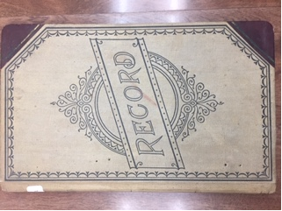
Thanks to our City Manager Jeff Towery, I recently had the privilege of cataloging and digitizing some of our earliest historical records.

Slide 24
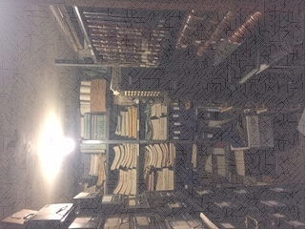
Special thanks to Rich Schmidt, Director of Archives & Resource Sharing at Linfield College for consulting on this project, and introducing the basics of handling and preserving these historic documents.

Slide 25
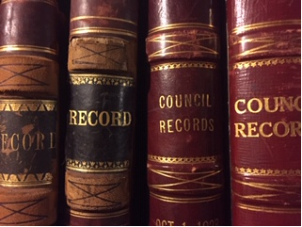
As we plan for the future of the city, it is fitting to look back at The stories that our early records tell.

Slide 26
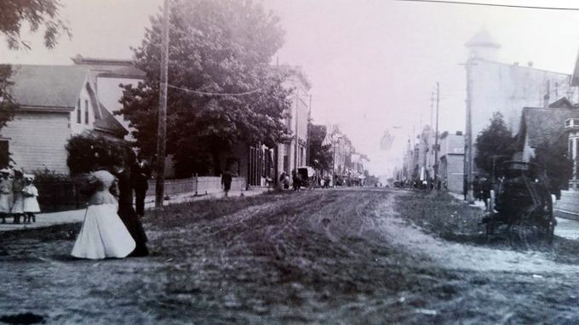
What would our great great grandparents think of all the changes that happened over the years?
https://www.historicmac.com/history, Photo of Third Street, Early 1900’s. Accessed November 19, 2019

Slide 27
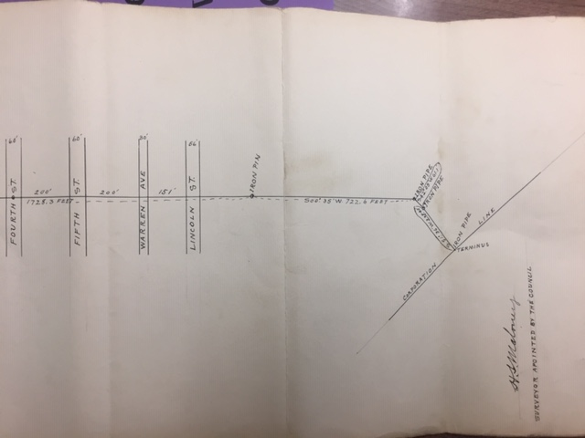
because of my background in planning and public administration, I gravitated towards the codes and maps. I looked at the documents through this lens.

Slide 28
A person with an interest in technology might note the changes in technology, even little things, such as how we fastened our paper.

Slide 29
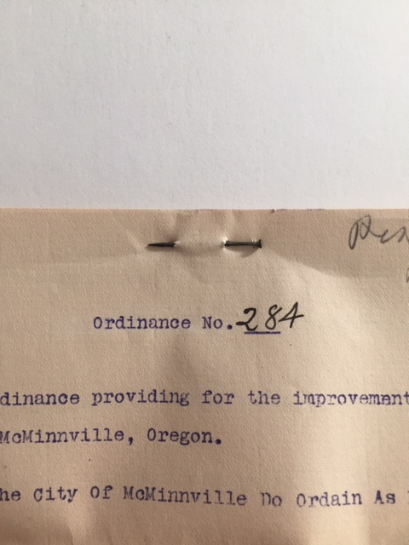
before the modern stapler was invented in 1937, we used push pins to fasten our documents

Slide 30
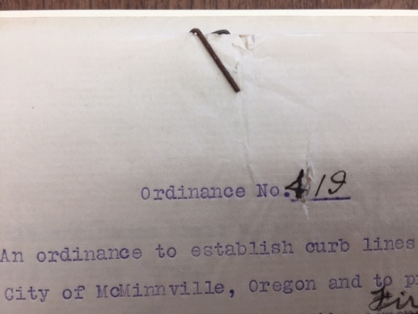
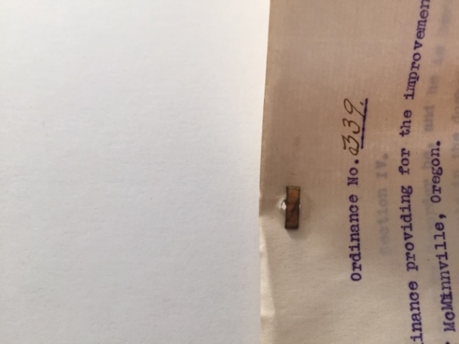
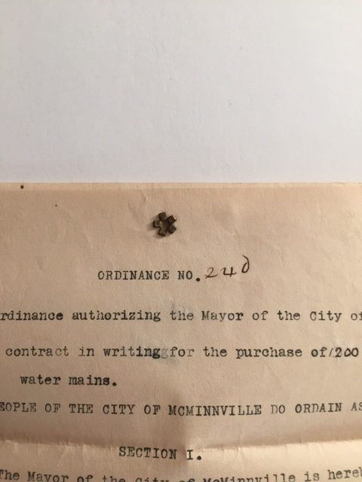
Then brads, fasteners and paper clips.

Slide 31
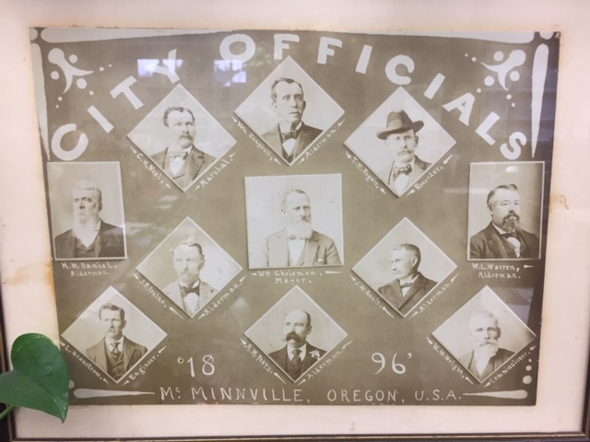
A historian might see The noted absence of the names of women throughout our early records, who would not be granted the right to vote until 1920.

Slide 32
Also missing are names of minorities.

Slide 33
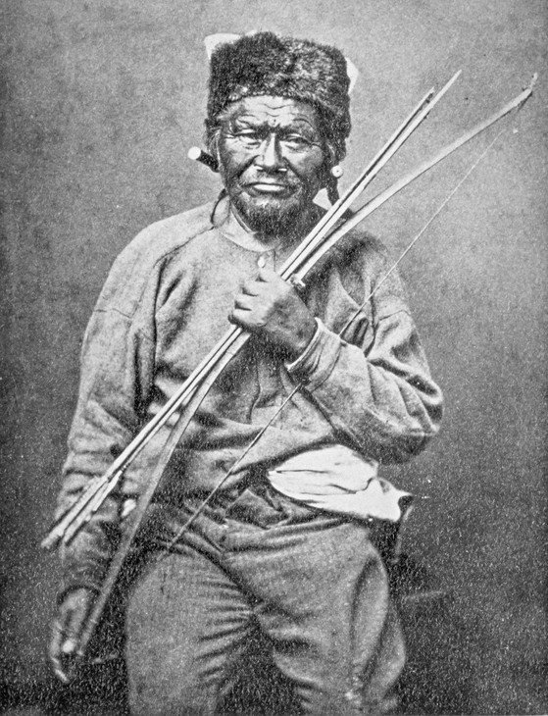
The historian would also note the lack of mention of the native oregonians, who cleared the land over 6000 years before newby platted the town
A Piute chief poses with a bow and arrows in this 1875 photo.
OREGON HISTORICAL SOCIETY, #BB012666
https://www.opb.org/artsandlife/series/brokentreaties/oregon-native-american-history-photos-pictures-tribal-tribes/, accessed November 19, 2019

Slide 34
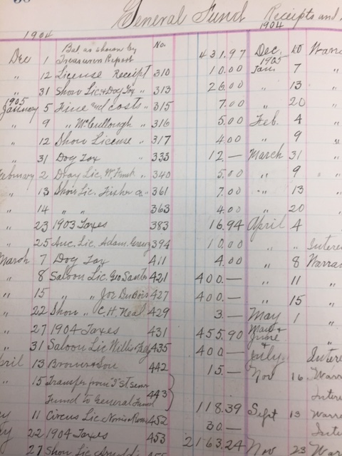
A finance person might look to the numbers. This 1904 general fund ledger shows license fees for businesses, and taxes.

Slide 35
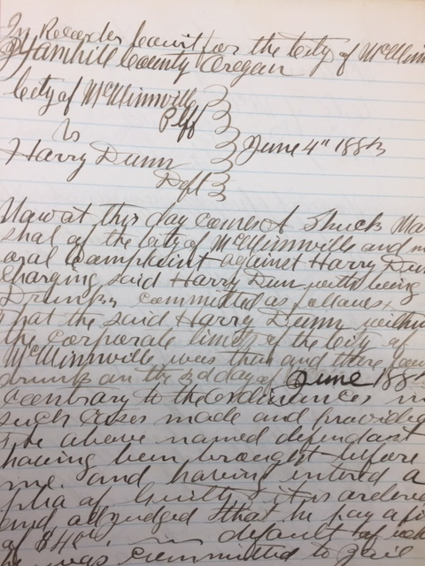
And people with a legal interest might find the first court cases fascinating, like this one from 1883.

Slide 36
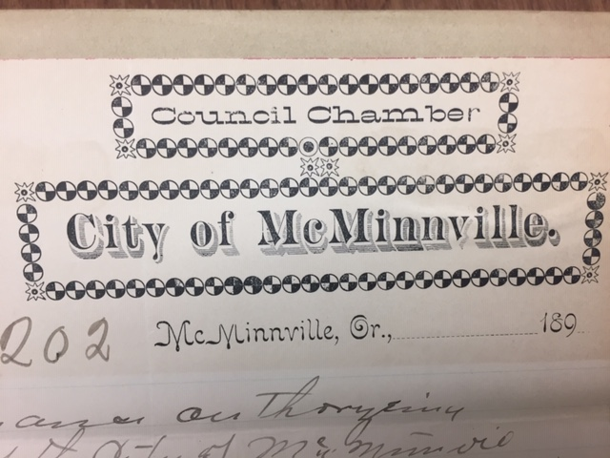
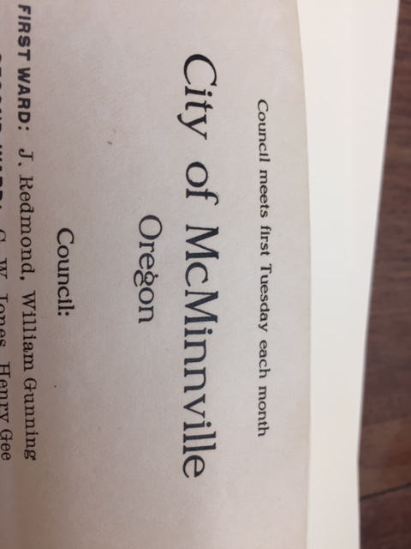
A graphics designer might be impressed with our letterhead from 1899 and from 1906

Slide 37
A linguist would note the changes in our language over the years. we called animals ‘beasts’, and referred to payments as “payable in gold or silver coin of the united states of America”.

Slide 38
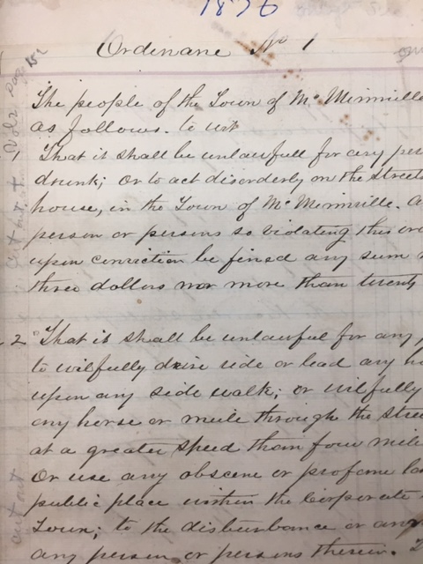
These are our records, to be interpreted by all. They are public and meant to be shared and remembered. These are the stories that I took away:

Slide 39
Housed in the city vault, in the basement of city hall, are our earliest records, from 1876.

Slide 40
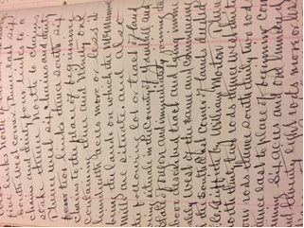
Our founding documents were beautifully crafted in hand written calligraphy. A stunning level of care and detail was exhibited.

Slide 41
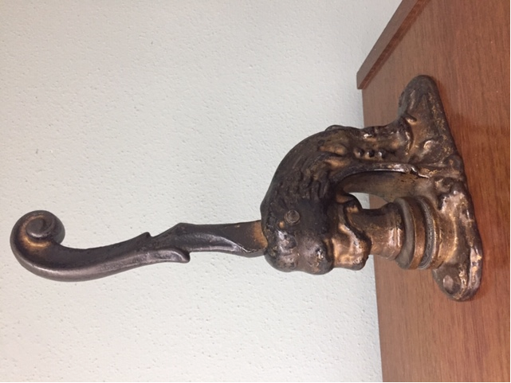
Each ordinance was stamped with our city seal, the same seal that sits on the city recorder’s desk today. *
*probably.

Slide 42
To build our city, we first established a safe and peaceful place to live.
McMinnville Fire Department, Photo ca 1900, https://mac100yearsago.wordpress.com/, Accessed November 19, 2019

Slide 43
We established a police and fire presence to protect public safety.

Slide 44
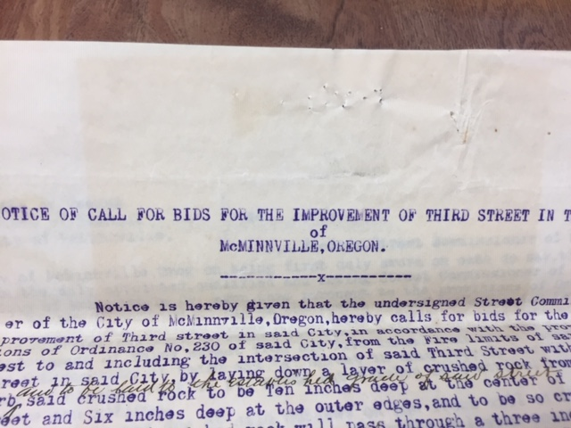
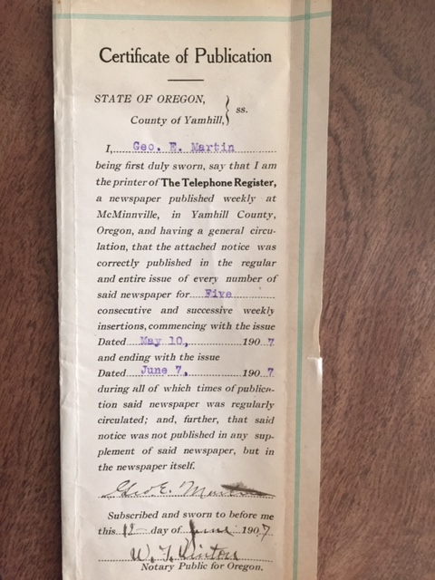
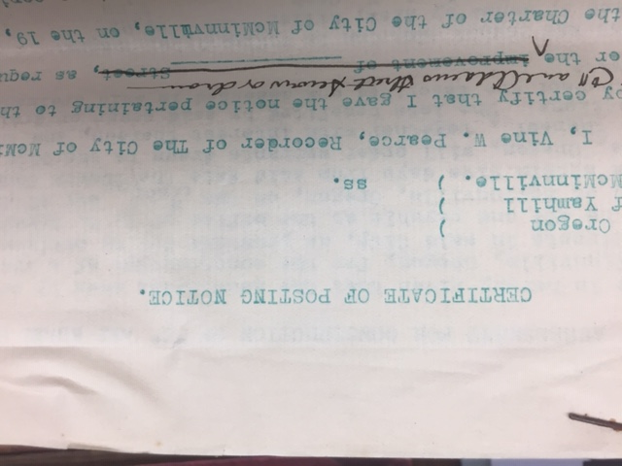
we gave public notice

Slide 45
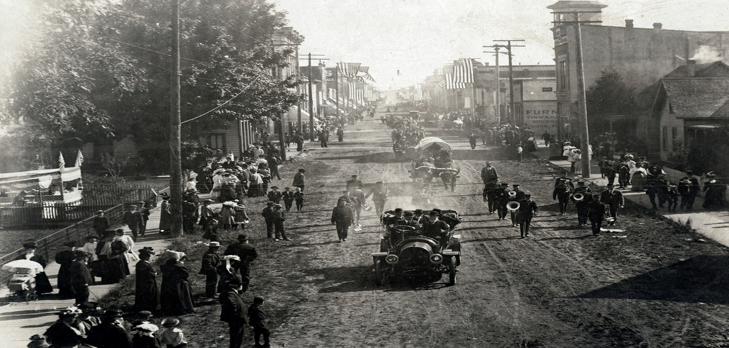
We cared about our infrastructure and passed hundreds of ordinances to improve sidewalks, sewers and streets.
https://www.historicmac.com/history, Photo taken early 1900’s of Thirst Street. Accessed November 19, 2019

Slide 46
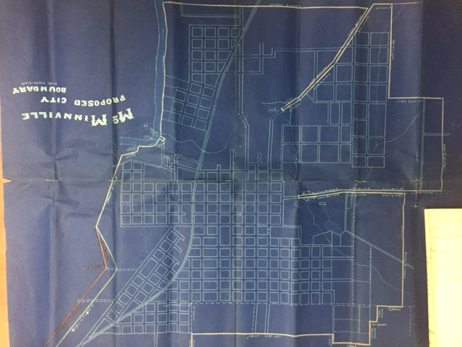
And laid the foundations for city planning, using a grid system.

Slide 47
Before roads, We built sidewalks. This picture from 1898 on third street shows dirt roads flanked by sidewalks.
Unknown, "McMinnville Band" (1898). Linfield College Archives Photograph Collection. Image. Submission 228. https://digitalcommons.linfield.edu/lca_photos/228

Slide 48
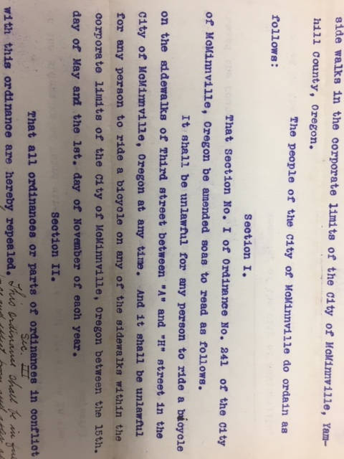
No bicycle riding on the sidewalks.

Slide 49
Seriously. The jail roster from 1890 shows that we meant it. No riding bikes on the sidewalks.

Slide 50
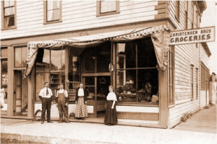
The records also give us insight to our economy: we were laborers, farmers, engineers, students, doctors, butchers, dentists, business owners, bankers, peddlers, and performers among others.
https://mac100yearsago.wordpress.com/daily-life/ Early 1900’s photo, Accessed November 19, 2019.

Slide 51
Our early codes also give us glimpses into the entertainment from 1880-1910 in McMinnville
Billy Rose Theatre Division, The New York Public Library. Couture Brothers (Vaudeville) Retrieved from http://digitalcollections.nypl.org/items/510d47de-b969-a3d9-e040-e00a18064a99

Slide 52
Television and radio were not yet invented, and the circus, vaudeville and other entertainers visited town
Billy Rose Theatre Division, The New York Public Library. (1890 - 1904). Walter L. Main 3 ring trained wild animal shows circus poster Retrieved from http://digitalcollections.nypl.org/items/510d47da-4ed5-a3d9-e040-e00a18064a99

Slide 53
And contributed to our economy with the appropriate licenses. $5.00 per day for a vaudeville show.
Photo: Historic Mac.com, Accessed November 19, 2019

Slide 54
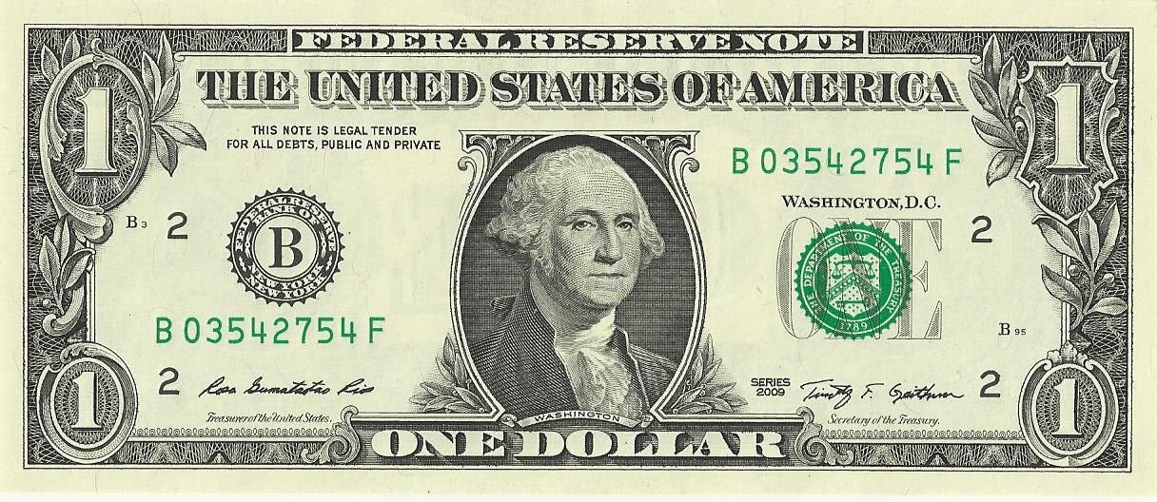
Peddlers also required licenses “for the privilege of peddling inside the city limits of McMinnville” $1.00 per day, collected by the city recorder.

Slide 55
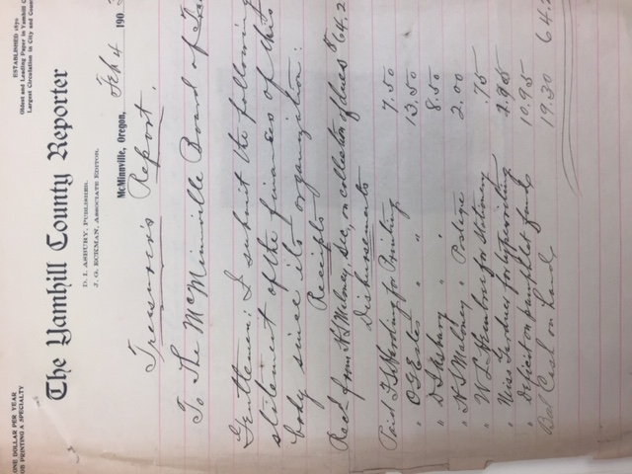
We kept meticulous records to properly document our spending and public processes.

Slide 56
We held elections.

Slide 57
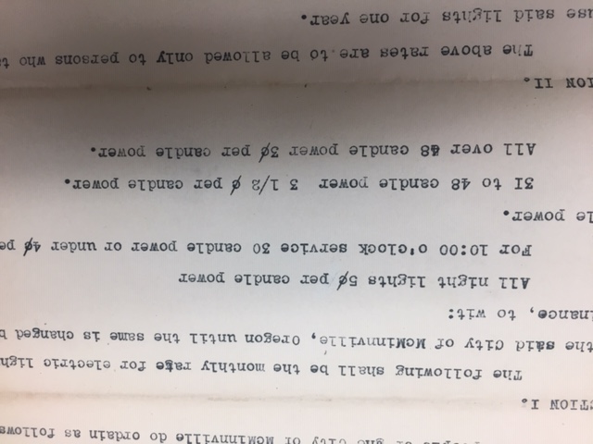
We established rates and regulations.

Slide 58
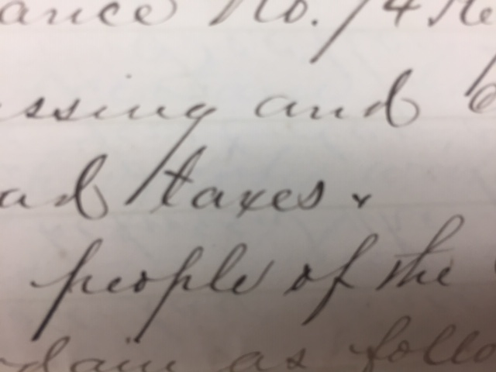
And collected taxes, for people to pay their share of city services.

Slide 59
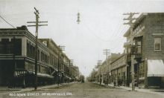
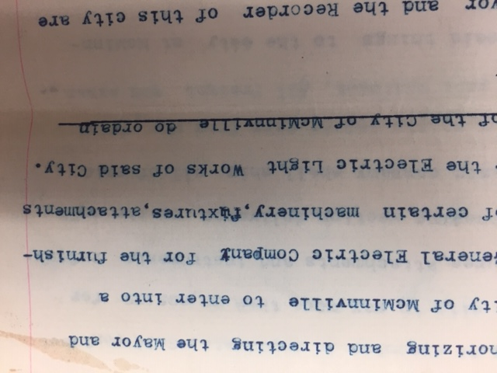
O.O Hodson Building,, Photo taken ca 1910, https://www.historicmac.com/o-o-hudson-building, Accessed November 19, 2019
WE CONRACTED WITH COMPANIES TO BUILD POLES TO RUN ELECTRICITY

Slide 60
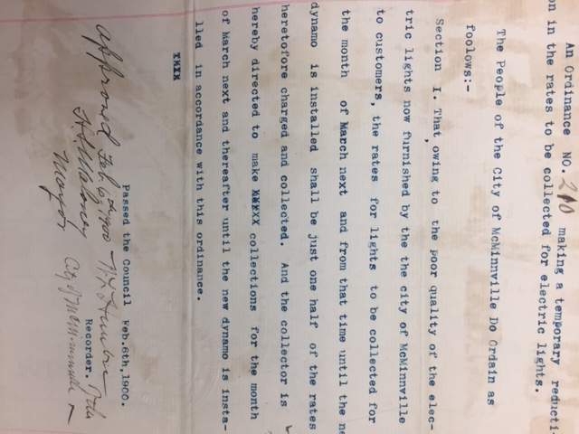
AND REFUNDED CUSTOMERS WHEN THE LIGHTS DID NOT WORK PROPERLY IN 1900.

Slide 61
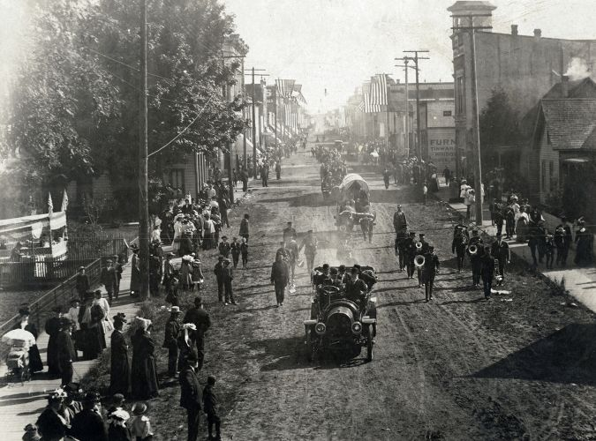
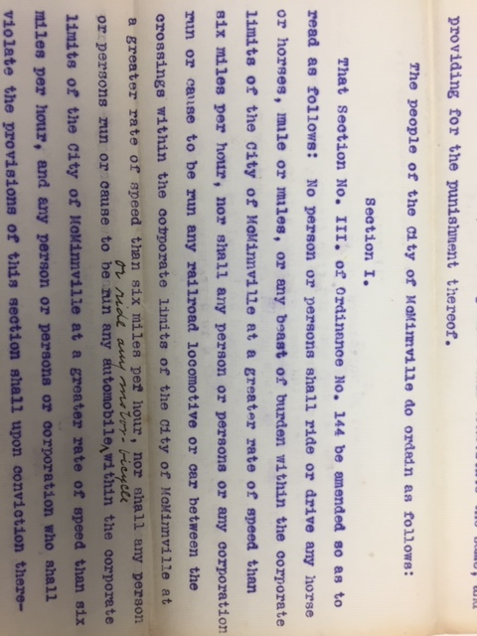
Photo credit: https://www.historicmac.com/historyEarly 1900’s photo, Accessed online November 19, 2019
WE SET SPEED LIMITS. THE FIRST AUTOMOBILE ARRIVED IN MCMINNVILLE IN 1903, AND A SIX MILE PER HOUR SPEED LIMIT WAS ORDAINED.

Slide 62
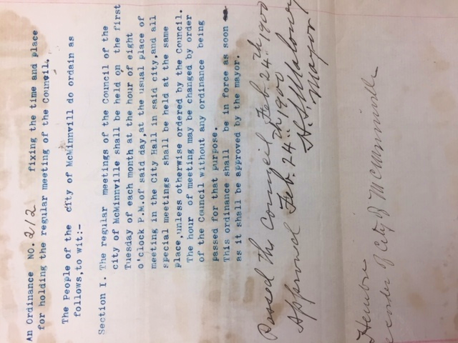
We established procedures. City council has met on Tuesdays for over 100 years, as ordained in 1900.

Slide 63
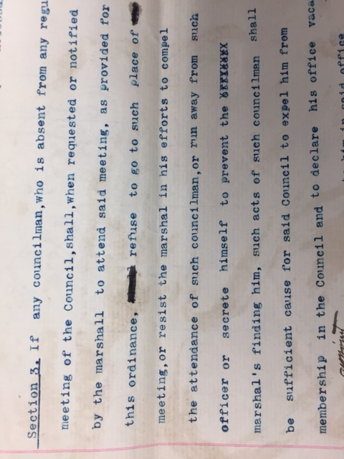
IN 1900, THE council COULD remove a councilor if HE refused to attend a meeting and ran away or hid from the marshal sent to collect him.

Slide 64
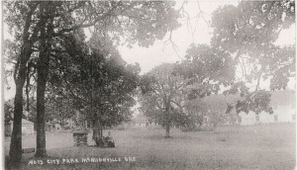
We established city park in 1906.
https://mac100yearsago.wordpress.com/daily-life/ Accessed on November 19, 2019

Slide 65
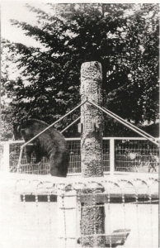
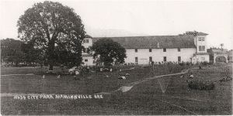
The park briefly was home to a bandstand, zoo, and pond in the early 1900’s.
Pictures of City park from Early 1900’s
https://mac100yearsago.wordpress.com/daily-life/. Accessed on November 19, 2019

Slide 66
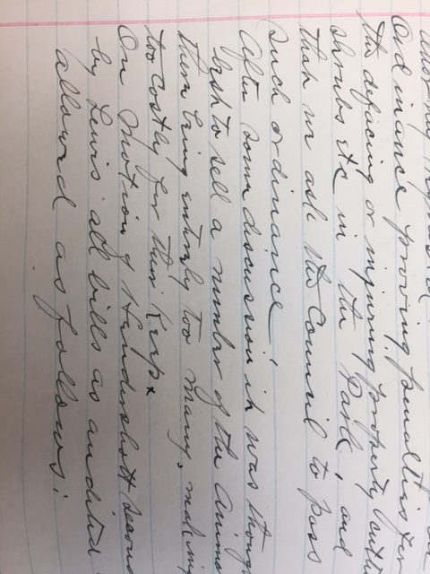
The zoo was closed in 1917 because the animals were “too many and too costly” according to park council minutes from 1917.

Slide 67
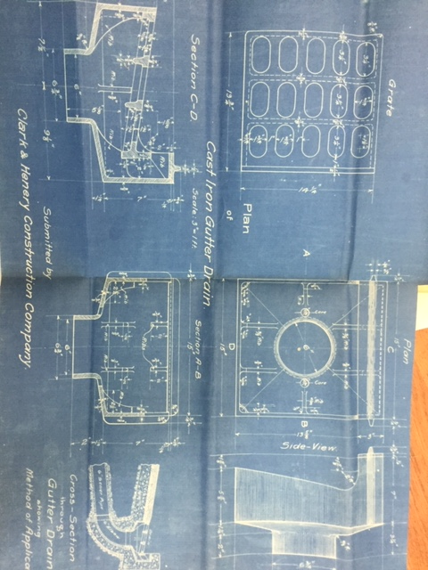
As our population grew, our codes and regulations reflected more clarity and detail, especially engineering and building specifications.
Photo credit: Oregon Historical Society, Corner of “f” Street, Circa 1920, Call number 005957 http://librarycatalog.ohs.org/O90000/OPAC/Details/Record.aspx?IndexCode=-1&TaskCode=1202069&HitCount=45&CollectionCode=2&SortDirection=Descending&CurrentPage=1&CurrentLinkCode=MO90000|4154499|1|14684091&SelectionType=0&SearchType=1&BibCode=MO90000|2767880|10|14684100

Slide 68
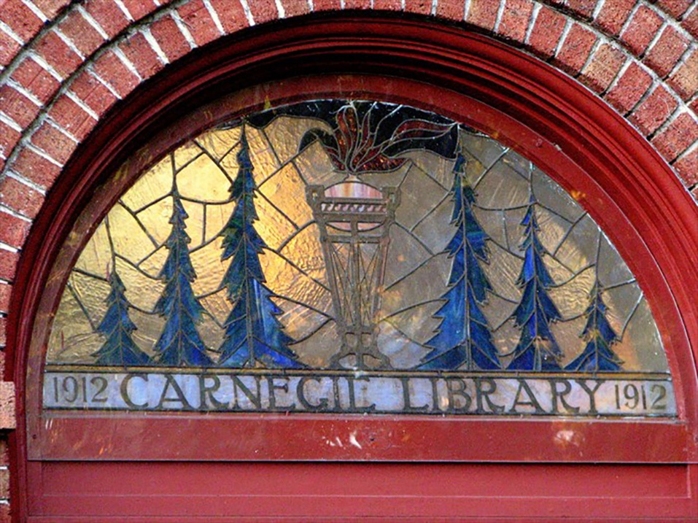
We created a library by ordinance in 1911, and built it in 1912.
https://www.historicmac.com/carnegie-library, Accessed November 19, 2019

Slide 69
The evolution of our city reflects our own: after we are safe and secure, we connect with to each other as we learn language, create art, establish and celebrate traditions, and participate in the world around us.

Slide 70
How will people look back on our work in 100 years?

Slide 71
Thank you for allowing me to be part of this project, and thank you for your civil service. It is appreciated, impactful and will be remembered. Cheers to those who served before us and cheers to those who will serve after. Music used with permission from: https://www.bensound.com

Slide 72
PRESENTATIONS
b. Planning Commission Annual Presentation

Slide 73
PLANNING COMMISSION ANNUAL REPORT

Slide 74
MEMBERSHIP
Nine Members
Ward Representation (2)
3 At-Large (including UGB)
Cross-section of citizens
4 Year Terms
3 Full Terms
Ex-Officio Youth

Slide 75
MEMBERSHIP
CITY COUNCIL, 12.10.18
Roger Hall, Chair
Lori Schanche, Vice-Chair Erin Butler
Martin Chroust-Masin Susan Dirks
Christopher Knapp Gary Langenwalter Roger Lizut Amanda Perron

Slide 76
RESPONSIBILITIES
Plan for growth and development in an orderly fashion with adequate resources for housing, business, industry, transportation, recreation, culture, comfort, health and welfare of McMinnville residents so that residents and businesses enjoy a high quality of life.
Advisory to City Council
Quasi Judicial Decision Making Body
CITY COUNCIL, 12.10.19

Slide 77
RESPONSIBILITIES
CITIZEN INVOLVEMENT COMMITTEE
Hosted 18 Public Hearings

Slide 78
LONG RANGE PLANNING NEEDS ASSESSMENT
State Law Mandates Federal Law Mandates Strategic Planning Foundational Documents
Comprehensive Plan
Development Code

Slide 79
WORK PLAN – FIVE YEARS
Long Range Plans
Comp Plan Amendments Zoning Ordinance Amendments
Funding = Grants
Academic Partnerships In-House Support
Mission Statement: Providing excellent customer service, public engagement, and proactive planning programs to promote McMinnville as the most livable and prosperous city in the state of Oregon now and into the future.

Slide 80
FIVE YEAR WORK PLAN

Slide 81
2018 IN REVIEW
SETTING THE TABLE:
Focus on Long Range Planning
Data Gathering and Citizen Engagement for Future Growth Discussions in McMinnville
Specialty Plans
Development Code Text Amendments
Quirky Infill Development – Nibbles Around the Edges

Slide 82
2019 IN REVIEW
PEOPLE CAME TO THE TABLE:
Focus on Long Range Planning
Data Gathering and Citizen Engagement for Future Growth Discussions in McMinnville
Specialty Plans
•
Quirky Infill Development –
Development Code Text Amendments
Nibbles Around the Edges

Slide 83
2019 IN REVIEW
PEOPLE CAME TO THE TABLE:
Focus on Long Range Planning
Data Gathering and Citizen Engagement for Future Growth Discussions in McMinnville
Specialty Plans
PLANNED DEVELOPMENT AMENDMENTS
RESPONDING TO HOUSING NEED

Slide 84
CURRENT PLANNING
27
Administer Development Code
Apply Comprehensive Plan,
3
Development Code, Zoning Map, Area Plans, etc. to specific properties – public and private
Land Use Decisions - Findings

Slide 85
CURRENT PLANNING
27
By the numbers . . . .
CPA | ZC | PD | PDA | CUP | SUB | VR | MP | LR
2 | 4 | 1 | 6 | 6 | 4 | 1 | 2 | 1

Slide 86
CURRENT PLANNING
27
By the numbers . . . .
CPA | ZC | PD | PDA | CUP | SUB | VR | MP | LR
2 | 4 | 1 | 6 | 6 | 4 | 1 | 2 | 1
667 Dwelling Units
(225 MF, 19 TH, 270 SFDU, 153 SM SFDU)

Slide 87
CHEGWYN VILLAGE – SMALL LOTS

Slide 88
OAK RIDGE MEADOWS

Slide 89
MEMORY CARE CENTER – 44 BEDS

Slide 90
SE NORTON LANE

Slide 91
BAKER CREEK NORTH

Slide 92
LONG RANGE PLANNING
6
Plan for the future of our community
Amend Development Code to reflect
10
changing community preferences and market conditions within the framework of the Comprehensive Plan.
Planning Framework & Major Projects

Slide 93
Ordinance No. 5066
G 1-19: Great Neighborhood Principles Comprehensive Plan Text Amendments
CITY COUNCIL 12.10.19

Slide 94
GREAT NEIGHBORHOOD PRINCIPLES
Natural Feature Preservation
Scenic View Preservation
Provide Parks and Open Spaces
Pedestrian Friendly
Bike Friendly
Connected Streets
Accessibility
Human Scale Design
Mix of Activities 10.Urban Rural Interface 11.Housing for Diverse
Incomes/Generations 12.Variety of Housing 13.Unique and Integrated Design
Elements
CITY COUNCIL 12.10.19

Slide 95
Ordinance No. 5068
G 2-19: Historic Preservation Plan Comprehensive Plan Text Amendments
CITY COUNCIL 12.10.19

Slide 96
HISTORIC PRESERVATION PLAN
Plan Components
Executive Summary
Introduction
Historic Context
Current Status of the Program
Goals, Policies, & Proposals
Implementation
Appendices
CITY COUNCIL. 12.10.19

Slide 97
Legislative Hearing
G 3-19: Zoning Ordinance Amendment
Innovative Housing Pilot Project Floating Zone
CITY COUNCIL 12.10.19

Slide 98
(ELIGIBILITY AREA)
CITY COUNCIL 12.10.19

Slide 99
Housing Strategy
and Housing Needs Report
CITY COUNCIL 12.10.19

Slide 100
BLI Results
12,739
people
5,002
Homes
2041
28,045
People
11,012
Homes
2067

Slide 101
EOA UPDATE / PUBLIC LANDS NEEDS
CITY COUNCIL 12.10.19

Slide 102
CITY COUNCIL 12.10.19

Slide 103
Study Area Context

Slide 104
CITY COUNCIL 12.10.19

Slide 105
FUTURE OUTLOOK

Slide 106
FIVE YEAR WORK PLAN

Slide 107
FIVE YEAR WORK PLAN

Slide 108
FIVE YEAR WORK PLAN

Slide 109
FIVE YEAR WORK PLAN

Slide 110
FIVE YEAR WORK PLAN
UGB Amendment

Slide 111
FIVE YEAR WORK PLAN
UGB Amendment HB 2001
Natural Resources Mapping

Slide 112
FIVE YEAR WORK PLAN
Airport Ec Dev Strategy Airport Zone
University Zone
UGB Amendment HB 2001
Natural Resources Mapping

Slide 113
REVISED FIVE YEAR WORK PLAN

Slide 114
REVISED FIVE YEAR WORK PLAN

Slide 116
McMINNVILLE'$
FUTURE
TOTAL POPULATION
GROWTH PEOPLE
GROWTH HOMES
,·,:,'·-, ,:::
6 2.80
4 28.04/
,5._ .
11. DI
i
· ·.i-·• ·. . .•
,,." .
- .

Slide 117
McMINNVILLE' $
FUTURE GROWTH

Slide 118
0
QI t t•''! " f' ft !M t f fr
MINDFULLY

Slide 119
SHOULD McMINNVILLE
GROW...
HIGHER DEHSITY
MAIHTAIH THE EXISTING MIX OF HOUSING TYPES
LARGE URBAN GROWTH
BOUNDARY EXPANSION
ADDITION OF HIGHER DENSITY RESIDENTIAL DEVELOPMENTS AND SINGLE FAMILY HOMES
SMALL URBAN GROWTH
BOUNDARY EXPANSION
RESIDENTIAL DEVELOPMENT
(,r l1'•d ,,t/, ,./(,, (. I f'I" 4 -r,,JH•• •>)
NO URBAN GROWTH
BOUNDARY EXPANSION

Slide 120
STAFF SUPPORT

Slide 121
STAFF SUPPORT
PLANNING STAFF:
Chuck Darnell Jamie Fleckenstein Sarah Sullivan Tom Schauer
CODE COMPLIANCE:
Claudia Martinez Nic Miles

Slide 122
Chair/Vice-Chair Comments
Roger Hall, Chair
Lori Schanche, Vice-Chair

Slide 123
PLANNING COMMISSION ANNUAL REPORT

Slide 124
ADVICE/ INFORMATION ITEMS
Reports from Councilors on Committee & Board Assignments
Water and Light Commissioner Appointment Jody Christensen

Slide 125
ADVICE/ INFORMATION ITEMS
Department Head Reports
Visit McMinnville Agreement
Settlement and Services Agreement (Material to be provided at council meeting)

Slide 126
CONSENT AGENDA
Consider request from CS Property Holdings LLC dba The Douglas on Third at 703 NE 3rd St. for an off-premises liquor license.
Consider request from Slake House LLC at 1036 NE Baker St. for a limited on-premises liquor license.
Consider request from Mikey’s Pizzeria dba Joysticks Arcade at 211 NE 3rd St. for a limited on-premises liquor license.
Consider Resolution 2019-64: A Resolution Approving Appointments for City Recorder and Finance Director.

Slide 127
ORDINANCE
Consider first reading with possible second reading of Ordinance No. 5083: An Ordinance Amending Ordinance No. 5018 relating to single use bags.

Slide 128
RESOLUTION
Consider Resolution No. 2019-65: A Resolution adopting a Building Fee Schedule.

Slide 129
RESOLUTION
Consider Resolution No. 2019-66: A Resolution authorizing City Committee/Commission Appointments.

Slide 130
RESOLUTION
Consider Resolution No. 2019-67: A Resolution authorizing the City Manager to enter into a contract with Cues, Inc. through the Houston Galveston Area Council Cooperative Purchasing Program (HGAC) for the purchase of a new CCTV Inspection Van.

Slide 131
Urban Renewal Agency Meeting
December 10, 2019

Slide 132
CONSENT AGENDA
Consider the Minutes of the June 25, 2019 Urban Renewal Agency Meeting.

Slide 133
RESOLUTION
Consider Resolution No. 2019-03: A Resolution appointing members to the McMinnville Urban Renewal Advisory Committee.

