Slide 1
Comprehensive Plan Amendment, Zone Change, Planned Development Amendment, Planned Development, Subdivision and Landscape Plan Requests
Ordinances 5084, 5085, 5086, 5087, 5088, & 5089
CPA 1-19/ZC 1-19/PDA 2-19/PD 1-19/S 1-19/L 12-19
Baker Creek North
City Council
January 14, 2020
CITY COUNCIL. 01.14.20

Slide 2
SITE LOCATION
CITY COUNCIL. 01.14.20

Slide 3
LAND USE REQUESTS
CPA 1-19, Comprehensive Plan Map Amendment on the southwestern portion of the site to reduce the size of an existing area designated as Commercial on the Comprehensive Plan Map. The proposed amendment would result in the Commercial designation being reduced from 11.3 acres to 6.62 acres, and the remaining 4.68 acres of existing Commercially designated land being designated as Residential;
ZC 1-19, Zone Change from mix of R-1 (Single Family Residential) and EF-80 (remnant County Exclusive Farm Use zone from prior to annexation) to a mix of 6.62 acres of C-3 (General Commercial) and 48.7 acres of R-4 (Multiple Family Residential);
CITY COUNCIL. 01.14.20

Slide 4
LAND USE REQUESTS
PDA 2-19, Planned Development Amendment to reduce the size of the existing Planned Development Overlay District governed by Ordinance 4633 to the size of the proposed 6.62 acre C-3 (General Commercial) site and amending the conditions of approval of the Commercial Planned Development Overlay District to allow up to 120 multiple family dwelling units and require a minimum of 2 acres of neighborhood commercial uses on the site;
PD 1-19, Planned Development to allow for the development of 280 single family detached dwelling units, public right-of way improvements, and open spaces on the proposed 48.7 acres of R-4 (Multiple Family Residential) land with modifications from the underlying zoning requirements for lot size, setbacks, lot dimensions and frontages, driveway widths, alley widths, block lengths, block perimeter lengths, street tree spacing standards, and street tree setbacks from utilities;
CITY COUNCIL. 01.14.20

Slide 5
LAND USE REQUESTS
S 1-19, Tentative Subdivision to allow for a 10-phase subdivision including a total of 280 single family detached dwelling units, public right-of-way improvements, and open spaces consistent with the proposed Planned Development plan;
L 12-19, Landscape Plan Review for the landscaping of proposed open space tracts within the subdivision phases and a street tree plan for the planting of street trees in the planter strips within the right-of-way adjacent to the single family dwelling unit lots.
All applications submitted for concurrent review per MMC Section 17.72.070
All applications subject to review process with City Council final decision
CITY COUNCIL. 01.14.20

Slide 6
SITE LOCATION
CITY COUNCIL. 01.14.20

Slide 7
SITE LOCATION
CITY COUNCIL. 01.14.20

Slide 8
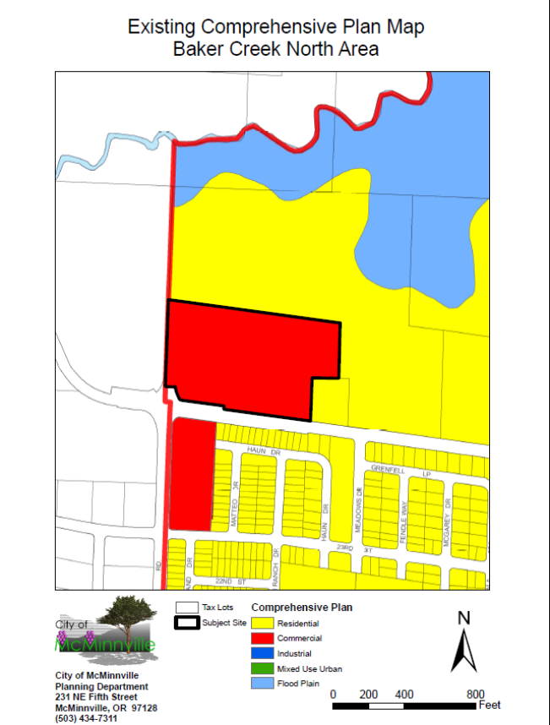
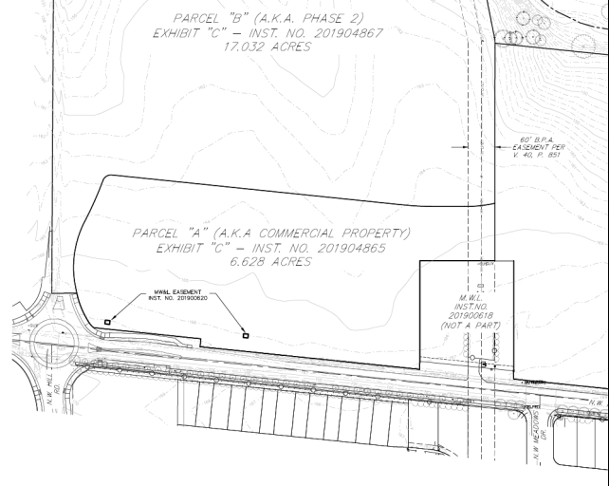
COMP PLAN DESIGNATION
CITY COUNCIL. 01.14.20

Slide 9
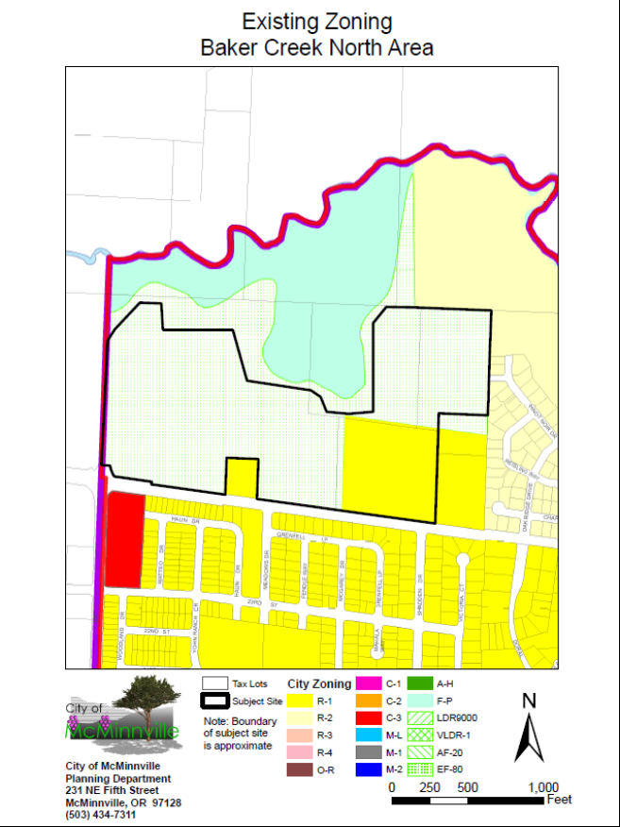
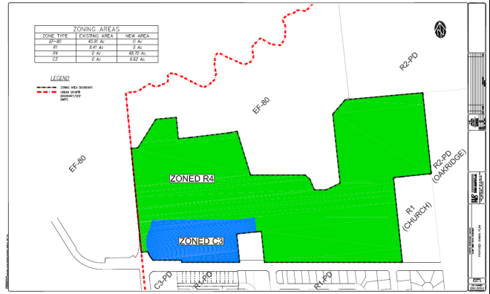
ZONING
CITY COUNCIL. 01.14.20

Slide 10
PROPOSED DEVELOPMENT PLAN
CITY COUNCIL. 01.14.20

Slide 11
Comprehensive Plan Amendment
CPA 1-19
CITY COUNCIL. 01.14.20

Slide 12
COMP PLAN AMDT. REVIEW CRITERIA
Section 17.74.020
The proposed amendment is consistent with the goals and policies of the Comprehensive Plan.
Deficit of Commercial and Residential lands
2001/2003 Buildable Lands Inventory and McMinnville Residential Land Needs Analysis & Growth Management Plan
Approximate need of 537 acres of Residential land
2013 Economic Opportunities Analysis:
CITY COUNCIL. 01.14.20

Slide 13
COMP PLAN AMDT. REVIEW CRITERIA
Section 17.74.020 also states that that when considering a comprehensive plan map amendment, “the housing policies of the McMinnville Comprehensive Plan shall be given added emphasis and the other policies contained in the plan shall not be used to: (1) exclude needed housing; (2) unnecessarily decrease densities; or (3) allow special conditions to be attached which would have the effect of discouraging needed housing through unreasonable cost or delay.”
Reduction of size of Commercial land adds 4.68 acres of Residential land (also in deficit), while still providing some Commercial land need (6.62 acres)
CITY COUNCIL. 01.14.20

Slide 14
COMP PLAN AMDT. REVIEW CRITERIA
Section 17.74.020
The proposed amendment is orderly and timely, considering the pattern of development in the area, surrounding land uses, and any changes which may have occurred in the neighborhood or community to warrant the proposed amendment.
Applicant cites housing need as a change in the community to warrant the amendment to reduce Commercial land and increase Residential land
Surrounding area is guided for Residential
Smaller Commercial designation will allow for more appropriately scaled commercial development
Neighborhood commercial intended for Commercial land (discussed in concurrent PDA 2-19 request)
CITY COUNCIL. 01.14.20

Slide 15
Zone Change
ZC 1-19
CITY COUNCIL. 01.14.20

Slide 16
ZONE CHANGE REVIEW CRITERIA
Section 17.74.020
The proposed amendment is consistent with the goals and policies of the Comprehensive Plan.
Chapter IV – Economy of McMinnville
Goal IV 3: To ensure commercial development that maximizes efficiency of land use through utilization of existing commercially designated lands, through appropriately locating future commercial lands, and discouraging strip development.
CITY COUNCIL. 01.14.20

Slide 17
ZONE CHANGE REVIEW CRITERIA
Proposed C-3 zoning consistent with area of site designated as Commercial on Comprehensive Plan Map (following CPA 1-19)
C-3 zone allows for diverse and more efficient use of site
However, existing PD will regulate use and development to ensure locational requirements and scale of commercial development are consistent with Comp Plan policies and support intended Neighborhood Commercial uses
Applicant proposing Planned Development Amendment
Planning Commission recommending ZC 1-19 not be approved unless PDA 2-19 approved
CITY COUNCIL. 01.14.20

Slide 18
ZONE CHANGE REVIEW CRITERIA
Section 17.74.020
The proposed amendment is consistent with the goals and policies of the Comprehensive Plan.
Chapter V – Housing and Residential Development
Goal V 1: To promote development of affordable, quality housing for all city residents.
Goal V 2: To promote a residential development pattern that is land-intensive and energy-efficient, that provides for an urban level of public and private services, and that allows unique and innovative development techniques to be employed in residential designs.
CITY COUNCIL. 01.14.20

Slide 19
ZONE CHANGE REVIEW CRITERIA
Policy 71.13: Criteria to determine if areas are appropriate for high-density residential development
Site meets most of the locational requirements for higher density housing
Located on arterial street and future transit corridor (Baker Creek Road)
Located adjacent to commercial services (proposed C-3 zoned portion of site)
Not subject to development limitations – located south of Baker Creek and floodplain lands
CITY COUNCIL. 01.14.20

Slide 20
ZONE CHANGE REVIEW CRITERIA
Site does not meet some of the locational requirements without more detail for development of site:
Adjacency to public or private open space
Ability to buffer from low density residential
Capacity of existing services to serve development
Traffic Impact Analysis does not analyze maximum development of R-4 zone
These issues are addressed in proposed Planned Development (PD 1-19 & PDA 2-19) applications with specific development plan
Planning Commission recommending ZC 1-19 not be approved unless PD 1-19 and PDA 2-19 are approved
CITY COUNCIL. 01.14.20

Slide 21
Planned Development Amendment
PDA 2-19
CITY COUNCIL. 01.14.20

Slide 22
PLANNED DEVELOPMENT AMENDMENT
Ordinance 4633 – Commercial Planned Development Overlay District
Request:
Reduce size of PD to be consistent with reduced Comprehensive Plan designation of Commercial land
Amend existing conditions of approval to allow:
Up to 120 multiple family units
Minimum of 2 acres of neighborhood commercial uses
No specific development plan submitted
CITY COUNCIL. 01.14.20

Slide 23
EXISTING PD (ORD 4633) CONDITIONS
No multiple-family residential use allowed
Minimum 14% landscaping (higher than standard C-3 zone)
Development plan review by Planning Commission
Building height limited to 35 feet
Limits on:
Commercial hours of operation
Lighting
Signage
Outside storage
CITY COUNCIL. 01.14.20

Slide 24
PD AMENDMENT REVIEW CRITERIA
Section 17.74.070
There are special physical conditions or objectives of a development which the proposal will satisfy to warrant a departure from the standard regulation requirements;
Objectives of the proposed Planned Development Amendment:
Introduce a mix of uses by allowing multiple family dwelling units
Provide “neighborhood commercial uses” within the site to serve surrounding residential development
City must find that these special objectives, either as proposed or as revised with conditions of approval, warrant a departure from the standard regulation requirements
As an existing Planned Development Overlay District, standard regulation requirements are those required by Ordinance 4633
CITY COUNCIL. 01.14.20

Slide 25
PD AMENDMENT REVIEW CRITERIA
Planning Commission found that special objectives can warrant departure from existing regulations in Ordinance 4633, if:
Development of site is designed appropriately given:
The location surrounded by residential uses and public parks
The intent to provide neighborhood serving commercial uses
Mixed uses (multiple family dwelling units and commercial uses) are integrated on site
Development of site is consistent with applicable Comprehensive Plan policies
CITY COUNCIL. 01.14.20

Slide 26
PD AMENDMENT REVIEW CRITERIA
Changes in conditions within City since original PD adoption in 1996:
Housing inventory and affordability issues
Residential Buildable Lands Inventory (acknowledged and more recent draft) identify need for additional residential land and dwelling units
Preservation of commercial uses in the NW area of the City
Current 11.3 acres is larger than necessary for neighborhood serving commercial uses
However, the City has planned for at least 5 acres of commercial development in the NW area since 1991 (Ordinance 4506)
In order to maintain space for commercial development, a minimum size of 5 acres is recommended by Planning Commission with allowance for integration of multiple family units
CITY COUNCIL. 01.14.20

Slide 27
PD AMENDMENT REVIEW CRITERIA
Section 17.74.070
Resulting development will not be inconsistent with the Comprehensive Plan objectives of the area;
Goal IV 3: To ensure commercial development that maximizes efficiency of land use […]
Policy 22.00: The maximum and most efficient use of existing commercially designated lands will be encouraged […]
Policy 68.00: The City of McMinnville shall encourage a compact form of urban development by directing residential growth close to the city center and to those areas where urban services are already available […]
Policy 69.00: The City of McMinnville shall explore the utilization of innovative land use regulatory ordinances which seek to integrate the functions of housing, commercial, and industrial developments into a compatible framework within the city.
CITY COUNCIL. 01.14.20

Slide 28
PD AMENDMENT REVIEW CRITERIA
Section 17.74.070
Resulting development will not be inconsistent with the Comprehensive Plan objectives of the area;
Suggested Condition of Approval:
2. That up to 120 multiple family dwelling units are allowed within the Planned Development Overlay District, but only if the multiple family units are integrated with neighborhood commercial uses. “Integrated” means that uses are within a comfortable walking distance and are connected to each other with direct, convenient and attractive sidewalks and/or pathways. This integration of multiple family units and neighborhood commercial uses shall either be within a mixed use building or in a development plan that integrates the uses between buildings in a manner found acceptable to the Planning Commission.
8. The minimum commercial development shall be five acres. Five acres of this site must retain ground floor commercial uses, allowing multiple family development to occur on the remainder of the site and as part of a mixed-use development. The five acres of commercial development will be calculated based upon all of the development requirements associated with the commercial development including any standards related to the mixed-use residential development.
CITY COUNCIL. 01.14.20

Slide 29
PD AMENDMENT REVIEW CRITERIA
Section 17.74.070
Resulting development will not be inconsistent with the Comprehensive Plan objectives of the area;
Policy 27.00: Neighborhood commercial uses will be allowed in residential areas. These commercial uses will consist only of neighborhood oriented businesses and will be located on collector or arterial streets. More intensive, large commercial uses will not be considered compatible with or be allowed in neighborhood commercial centers.
Suggested Condition of Approval:
3. For the purposes of this Planned Development Overlay District, allowed neighborhood commercial uses are defined as those that are permitted in the C-1 (Neighborhood Business) zone in Section 17.27.010 of the MMC. In addition, “Restaurant” shall be permitted as a neighborhood commercial use in this Planned Development Overlay District. No retail uses should exceed 10,000 square feet in size, except for grocery stores. The applicant may request any other use to be considered permitted within the Planned Development Overlay District at the time of the submittal of detailed development plans for the site.
CITY COUNCIL. 01.14.20

Slide 30
PD AMENDMENT REVIEW CRITERIA
17.27.010 Permitted uses. In a C-1 zone, the following uses and their accessory uses may be permitted:
Bakery, provided all products produced are sold only at retail on the premises;
Barbershop or beauty shop;
Confectionery or candy store, provided all products produced are sold only at retail on the premises;
Drugstore or pharmacy;
Florist, garden shop or nursery, retail;
Food store, retail;
Laundry or dry cleaning distributing station;
Laundry or dry cleaning, self-service;
Medical or dental office;
Shoe repair shop;
Sewage pump station;
Wireless communications facilities, not to include antenna support structures and their associated facilities, subject to the provisions of Chapter 17.55 (Wireless Communications Facilities).
CITY COUNCIL. 01.14.20

Slide 31
PD AMENDMENT REVIEW CRITERIA
Section 17.74.070
Resulting development will not be inconsistent with the Comprehensive Plan objectives of the area;
Policy 24.00: The cluster development of commercial uses shall be encouraged rather than auto-oriented strip development.
Policy 25.00: Commercial uses […] where conflicts with adjacent land uses can be minimized […]
Policy 26.00: The size of, scale of, and market for commercial uses shall guide their locations […]
CITY COUNCIL. 01.14.20

Slide 32
PD AMENDMENT REVIEW CRITERIA
Section 17.74.070
Resulting development will not be inconsistent with the Comprehensive Plan objectives of the area;
Policy 29.00: New direct access to arterials by large-scale commercial developments shall be granted only after consideration is given to the land uses and traffic patterns in the area […] Internal circulation roads, acceleration/deceleration lanes, common access collection points, signalization, and other traffic improvements shall be required wherever necessary […]
Policy 31.00: Commercial developments […] minimizes bicycle/pedestrian conflicts and provides pedestrian connections to adjacent residential development through pathways […]
Proposal 6.00: A planned development overlay should be placed on the large cluster commercial development areas and the entrances to the City to allow for review of site design, on-site and off-site circulation, parking, and landscaping.
CITY COUNCIL. 01.14.20

Slide 33
PD AMENDMENT REVIEW CRITERIA
Section 17.74.070
Resulting development will not be inconsistent with the Comprehensive Plan objectives of the area;
Suggested Condition of Approval:
4. Detailed development plans showing elevations, site layout, signing, landscaping, parking, and lighting must be submitted to and approved by the Planning Commission before actual development may take place. The provisions of Chapter 17.51 of the McMinnville Zoning Ordinance may be used to place conditions on any development and to determine whether or not specific uses are permissible. The detailed development plans shall identify the site design components listed below […]
Site Design Components:
Shared Access Points & Internal Circulation
Parking Location Behind Building
Parking Maximums (110% of minimum)
Building Orientation Toward Right-of-Ways
Human Scale Building Façade Features
Building Height: Maximum 45 Feet
Pedestrian Connections & Amenities
Landscaping (minimum 14% of site)
Community Gathering Space
Open Space for Multiple Family Units (minimum 10% of site)
Signs (appropriate for mixed use & neighborhood commercial buildings)
Lighting
CITY COUNCIL. 01.14.20

Slide 34
PD AMENDMENT REVIEW CRITERIA
Resulting development will not be inconsistent with the Comprehensive Plan objectives of the area;
Policy 29.00: New direct access to arterials by large-scale commercial developments shall be granted only after consideration is given to the land uses and traffic patterns in the area of development as well as at the specific site. Internal circulation roads, acceleration/deceleration lanes, common access collection points, signalization, and other traffic improvements shall be required wherever necessary, through the use of planned development overlays.
Policy 30.00: Access locations for commercial developments shall be placed so that excessive traffic will not be routed through residential neighborhoods and the traffic-carrying capacity of all adjacent streets will not be exceeded.
Suggested Condition of Approval:
7. Prior to any future development of the site, a traffic impact analysis shall be provided. The traffic impact analysis shall include an analysis of the internal circulation system, the shared access points, and the traffic-carrying capacity of all adjacent streets and streets required to provide eventual access to Baker Creek Road.
CITY COUNCIL. 01.14.20

Slide 35
Planned Development
PD 1-19
CITY COUNCIL. 01.14.20

Slide 36
PLANNED DEVELOPMENT
New Planned Development Overlay District to allow:
280 Single Family Residential Lots
18 Open Space Tracts
Dedication of Parcel for Public Park
Includes requests for modifications from:
Minimum lot sizes (use of lot size averaging)
Reduced side yard setbacks
Lot dimensions (exceeding a 2:1 depth-to-width ratio)
Driveway & alley widths
Block length and block perimeter lengths
Street tree spacing standards
CITY COUNCIL. 01.14.20

Slide 37
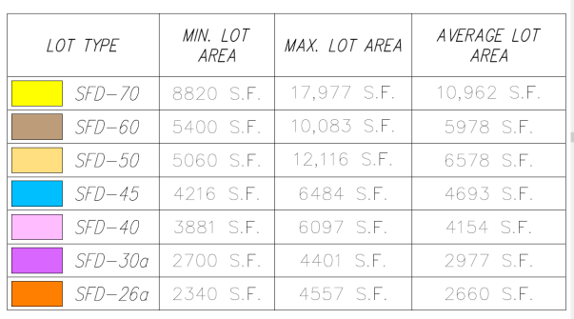
LOT TYPES
CITY COUNCIL. 01.14.20

Slide 38
SETBACKS
Reduced setbacks requested as follows:
SFD-70, SFD-60, SFD-50, and SFD-40: Minimum 5 foot side yard setback
SFD-45: Minimum 4 foot side yard setback
SFD-30a and SFD-26a: Minimum 3 foot side yard setback
Lots 131-135 and Lots 269-280: Minimum 30 foot rear yard setback (for tree preservation)
All front, exterior side, and rear setbacks (other than increase above) to follow R-4 requirements
CITY COUNCIL. 01.14.20

Slide 39
TYPICAL SMALL LOTS
CITY COUNCIL. 01.14.20

Slide 40
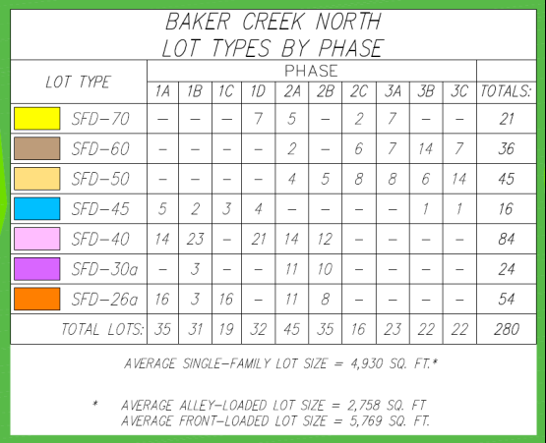
LOT TYPES BY PHASE
CITY COUNCIL. 01.14.20

Slide 41
PD REVIEW CRITERIA
Section 17.51.030(C)
There are special physical conditions or objectives of a development which the proposal will satisfy to warrant a departure from the standard regulation requirements;
Applicant’s stated special objectives:
Preserve trees in rear yards and tracts.
Accommodate homes along the bluff while keeping appropriate separation from the natural areas on the adjacent property.
Developing around the BPA Easement that traverses the site.
Provide a diversity of lot sizes to accommodate a mix of housing sizes at various price points to meet the goals and policies of the City’s Comprehensive Plan and this code to serve today’s market needs of home consumers in McMinnville.
Focus on the detached Single-Family Residential housing type.
Offer on-site open space amenities to the residents who cannot cross a minor arterial to reach the nearest neighborhood park.
Provide access to City park facilities.
Create a sense of place.
Ensure adequate off-street parking.
Avoid “cookie cutter” approach to housing on any block face.
Promote future transit service.
CITY COUNCIL. 01.14.20

Slide 42
TREE PRESERVATION
Trees proposed to be preserved in open space tracts and rear yards
Conditions of Approval:
Condition #3: Require larger rear yard setback on Lots 131-135 and Lots 269-280
Condition #14: Require tree inventory and arborist’s report prior to any removal of tree greater than 9 inches DBH (other than those shown to be removed in L 12-19)
CITY COUNCIL. 01.14.20

Slide 43
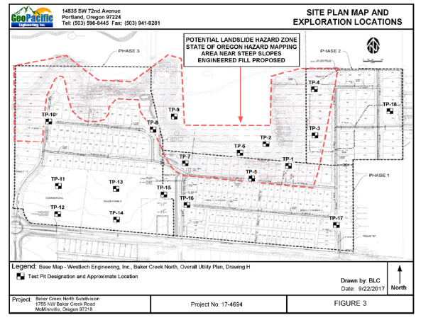
NATURAL AREA PRESERVATION
Larger lots located along bluff and sloped area on north end of site
Dedication of “Parcel D” & floodplain
Conditions of Approval #12 & #13: Require recommended geo-tech analysis prior to development & geo-tech recommendations during construction
CITY COUNCIL. 01.14.20

Slide 44
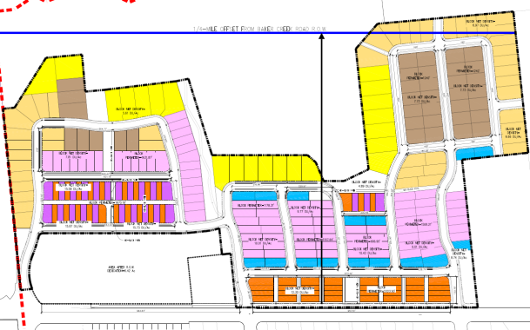
MIX OF HOUSING TYPES
Transition from higher to lower density (south to north)
Provide more dense lot types near arterial street and future transit route (Baker Creek Road)
Less dense lot types along bluff and sloped portions of site to transition between development and natural areas
Condition of Approval #1 & #2: Require plan to be binding on site, and allow lot size averaging as proposed
CITY COUNCIL. 01.14.20

Slide 45
MIX OF HOUSING TYPES
Smaller lots proposed to be alley-loaded
Reduce vehicle conflicts with sidewalk space
Lessen garage door prominence on front façade
Some front onto common open space tracts
Conditions of Approval #15 & #16: Require lots less than 40’ wide to be alley loaded, and alleys to be private
CITY COUNCIL. 01.14.20

Slide 46
OPEN SPACE AMENITIES
18 open space tracts proposed
City to accept Tracts G, I, J, K & L
Tracts A – F, H and N – S to be private & maintained by HOA
Conditions of Approval #5, 7 & 8: State which tracts are accepted by City and require improvements as shown in plans (or amended by condition of approval)
CITY COUNCIL. 01.14.20

Slide 47
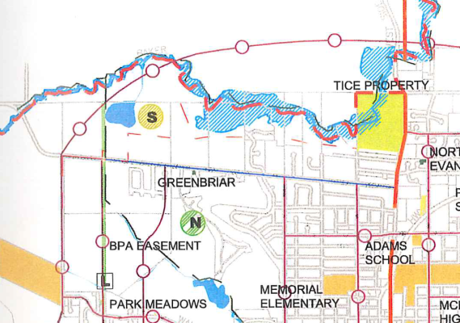
CITY PARK DEDICATION
Parks Master Plan Actions
Special Use Parks: Acquire a special use park adjacent to the BPA Easement/acquire Elks Park
Greenspace/Greenway: Acquire a greenway along Baker Creek connecting Tice/BPA Easement
Trails and Connectors: Develop the Westside Trial (BPA Easement)
Trails and Connectors: Develop a trail in the Baker Creek greenway
CITY COUNCIL. 01.14.20

Slide 48
BPA EASEMENT & TRAIL
Conditions of Approval #5 - 7: Require dedication of BPA Trail tracts (Tracts I, J, K & L) and require trail improvement to same standard as exists south of Baker Creek Road
Condition #9: Require additional connection for pedestrian access from NW area of site
Condition #11: Enhanced x-ing at Kent Street
CITY COUNCIL. 01.14.20

Slide 49
CITY PARK DEDICATION
Condition of Approval #6: Require dedication of park parcel and easement to connect to Oak Ridge Meadows
Condition of Approval #7: Require improvement of BPA trail, BPA trailhead terminus & greenway trail around floodplain
CITY COUNCIL. 01.14.20

Slide 50
PRIVATE RECREATIONAL AMENITIES
CITY COUNCIL. 01.14.20

Slide 51
OFF-STREET PARKING
Applicant requested driveways wider than allowed by MMC:
SFD-70 & SFD-60 lots: 30’
SFD-40 lots: 20’
SFD-45 lots: 18’
SFD-30a & SFD-26a lots: driveways the same width of the dwelling from an alley
Condition of Approval #18: Allow driveway widths proposed on private lots, but require driveway width to not exceed maximum width between property line and street (no more than 40% of lot frontage)
To reduce vehicle conflicts in sidewalk and provide more space for trees & utilities
Except for SFD-40 lots
CITY COUNCIL. 01.14.20

Slide 52
AVOID “COOKIE CUTTER” HOUSING
Lot sizes and dimensions proposed will result in denser detached single family housing
To avoid “cookie cutter” housing as described by the applicant, Planning Commission recommending that specific design standards apply at the time of building permit review:
Condition of Approval #20: Design standards related to:
Style & Massing
Quality & Type of Exterior Materials
Front Porches/Entry Areas
Roof Design & Materials
Exterior Doors & Windows
Garage Door Types
Exterior Lighting
Exterior Colors
Condition of Approval #21: Not allow any same house design in adjacency to another, including both sides of the street
CITY COUNCIL. 01.14.20

Slide 53
OTHER PROPOSED DESIGN FEATURES
Condition of Approval #10: Require proposed meandering, wider sidewalk along Baker Creek Road
CITY COUNCIL. 01.14.20

Slide 54
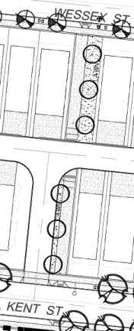
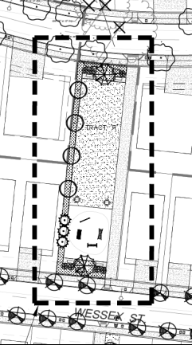
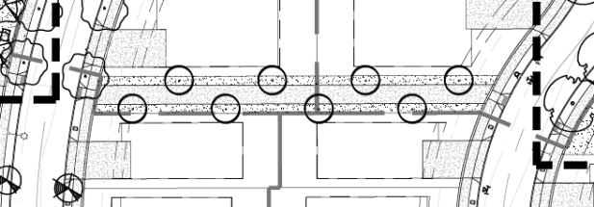
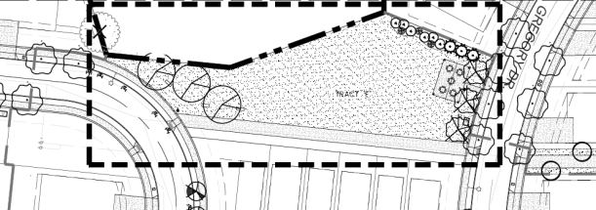
OTHER PROPOSED DESIGN FEATURES
Condition of Approval #19: Allow longer block lengths and block perimeter lengths
Mid-block pedestrian connections proposed
CITY COUNCIL. 01.14.20

Slide 55
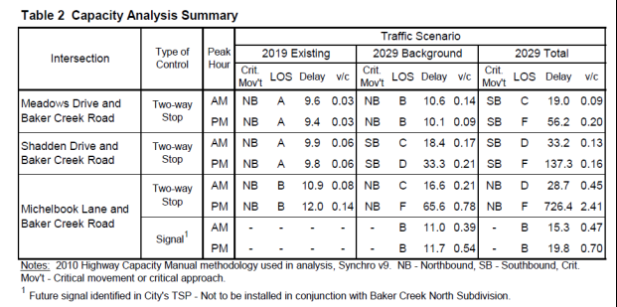
PD REVIEW CRITERIA
Section 17.51.030(C)
The streets are adequate to support the anticipated traffic, and the development will not overload the streets outside the planned area;
Proposed utility and drainage facilities are adequate for the population densities and type of development proposed;
CITY COUNCIL. 01.14.20

Slide 56
Tentative Subdivision
S 1-19
CITY COUNCIL. 01.14.20

Slide 57
TENTATIVE SUBDIVISION REQUEST
Subdivision consistent with Baker Creek North Planned Development plans (PD 1-19)
Request:
280 lot detached single family subdivision
10 Phases
Criteria:
Chapter 17.53 - Land Division Standards
Requirements of PD 1-19
CITY COUNCIL. 01.14.20

Slide 58
S 1-19 REVIEW CRITERIA
Chapter 17.53 – Land Division Standards
Approval of Streets and Ways
17.53.101 – Streets
Alignment with surrounding existing streets
Hill Road
Meadows Dr
Shadden Dr
Connections to surrounding subdivisions
Shadden Dr
Blake St
CITY COUNCIL. 01.14.20

Slide 59
S 1-19 REVIEW CRITERIA
Approval of Streets and Ways (cont’d)
17.53.105 – Lots
Consistent with PD 1-19
Size and shape of lots are appropriate for proposed use, respond to topographic conditions of site
Street access provided to each proposed lot per City standards
Alley access on smaller lots per PD 1-19
CITY COUNCIL. 01.14.20

Slide 60
S 1-19 CONDTIONS OF APPROVAL
Plat Phasing:
Condition of Approval #5: Approve phasing as shown in EXH-6 (10 phases)
Conditions of Approval #6 & #7:
Phase 1A to expire 2 years from date of approval
Each subsequent phase expire 5 years from date of approval
Allows for applicant’s proposed tentative timeframe:
Phase 1A-1D: 2019-2021
Phase 2A-2C: 2021-2024
Phase 3A-3C: 2020-2024
Some phases may be constructed concurrently
CITY COUNCIL. 01.14.20

Slide 61
S 1-19 CONDTIONS OF APPROVAL
Lot Sales Policy:
Policy 99.10: The City of McMinnville recognizes the value to the City of encouraging the sale of lots to persons who desire to build their own homes. Therefore, the City Planning staff shall develop a formula to be applied to medium and large size subdivisions, that will require a reasonable proportion of lots be set aside for owner-developer purchase for a reasonable amount of time which shall be made a part of the subdivision ordinance.
Condition of Approval #8: That the applicant shall provide twenty-five percent (25%) of the single family lots within each phase of the subdivision for sale for a period of six months for each subdivision phase. The applicant shall provide information detailing the number of lots that will be made available for individual sale for review and approval by the Planning Director prior to recording of the final plat for each subdivision. Upon approval, the referenced lots will be made available for sale to the general public for a minimum of one hundred eighty (180) days prior to building permit issuance for said lots.
CITY COUNCIL. 01.14.20

Slide 62
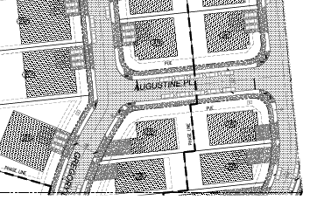
S 1-19 CONDTIONS OF APPROVAL
Condition of Approval #13: Redesign of intersection geometry at Gregory & Augustine Streets
Condition of Approval #14: Require alleys to be private either in tract or easement
CITY COUNCIL. 01.14.20

Slide 63
S 1-19 CONDTIONS OF APPROVAL
General Conditions:
CC&Rs and Homeowner’s Association
Assume maintenance of open space tracts and public park until 2032
Right-of-way dedication along Baker Creek Road
Standards for right-of-way improvements
Process for improvements and review of final plats
Requirement for applicant to obtain permits (if necessary) from:
Department of Environmental Quality (stormwater and water quality)
Department of State Lands
US Army Corps of Engineers
CITY COUNCIL. 01.14.20

Slide 64
Landscape Plan Review
L 12-19
CITY COUNCIL. 01.14.20

Slide 65
L 12-19 – LANDSCAP PLAN REVIEW
Application includes:
Request for Tree Removals
Removal of 17 deciduous trees
Street Tree Plan for New & Improved Public Right-of-Ways
Landscaping in Open Space Tracts
Private open space tracts
Tracts to be dedicated as public parks
CITY COUNCIL. 01.14.20

Slide 66
L 12-19 CONDTIONS OF APPROVAL
Verifying approved tree species
Allowing variations in spacing of street trees
Identification of additional locations for street trees
Requiring tree species appropriate for planting near overhead electrical transmission line (BPA easement)
Other typical conditions:
Setbacks from utilities
Planting standards
Requiring submittal of revised landscape plan that achieves all required conditions of approval
CITY COUNCIL. 01.14.20

Slide 67
L 12-19 CONDTIONS OF APPROVAL
Require submittal of landscape and development plan for public sewer pump station (Tract G)
Include street trees along Tract G
Screening of pump station
Minimum 25% of site landscaped
CITY COUNCIL. 01.14.20

Slide 68
PUBLIC HEARING & NEIGHBORHOOD MEETING PROCESSES
Neighborhood Meeting – November 1, 2018
10 attendees
Planning Commission Public Hearing – December 5, 2019
Two items of written public testimony received:
Letter – Patty O’Leary – Received 12/4/19
Letter – Markus Pfahler – Received 12/5/19
Three people testified in opposition
Opposition testimony related to:
Reduction of Commercial land, traffic on Baker Creek Road, design and architectural standards, housing mix, mass and scale of project
Applicant testimony:
Concern with some architectural standards and driveway limitations
CITY COUNCIL. 01.14.20

Slide 69
SITE HISTORY
Ordinance 4506:
Designated 5 acres of Commercial land south of Baker Creek Road
Ordinance 4626:
Reduced Commercial land south of Baker Creek Road and allowed multiple family (currently being built-out)
Condition of approval that land north of Baker Creek Road be changed to commercial with no multiple family
Ordinance 4633:
Separate land use application that designated 12.34 acres of Commercial land north of Baker Creek Road
Condition of approval that prohibits multifamily
CITY COUNCIL. 01.14.20

Slide 70
SITE HISTORY
Ord 4626
Ord 4633
CITY COUNCIL. 01.14.20

Slide 71
SITE HISTORY
Ordinance 5021:
Approved Planned Development Amendment on land south of Baker Creek Road
Approved Baker Creek West and Baker Creek East (currently being built-out)
Repealed Ordinance 4626 – no longer in effect
Ordinance 5076:
Reduced size of existing Planned Development Overlay District regulated by 4633
McMinnville Water & Light substation expansion
CITY COUNCIL. 01.14.20

Slide 72
NEIGHBORHOOD ACTIVITY CENTER
CITY COUNCIL. 01.14.20

Slide 73
PC RECOMMENDATION
CPA 1-19: Approval
ZC 1-19: Approval with conditions
Recommendation: Not be approved unless PDA 2-19 & PD 1-19 are approved
PDA 2-19: Approval with conditions
PD 1-19: Approval with conditions
S 1-19: Approval with conditions
Recommendation: Not be approved unless PD 1-19 is approved
L 12-19: Approval with conditions
Recommendation: Not be approved unless S 1-19 is approved
CITY COUNCIL. 01.14.20

Slide 74
CITY COUNCIL OPTIONS
Complete 1st (and possible 2nd) reading of ordinances as recommended by Planning Commission
or
Call for public hearing on applications
Would be held on January 28th, 2020
Per direction during department head comments at December 10, 2019 Council meeting, public hearing notice has been mailed in order to meet required notification timeframe
CITY COUNCIL. 01.14.20

Slide 75
QUESTIONS?
CITY COUNCIL. 01.14.20

