Slide 1
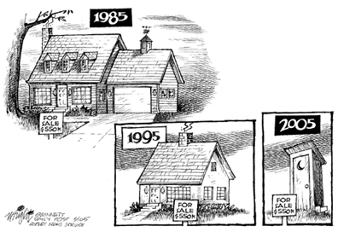
McMinnville Affordable Housing Task Force
ANNUAL UPDATE
Accomplishments
Next Steps
2000
2020 - ?
2020
2010
CITY COUNCIL. 2.11.20

Slide 2

TONIGHT’S PRESENTATION
Why there is an Affordable Housing Task Force?
Who is on the Task Force?
Our Action Plan
Accomplishments in the
Past Year
Next Steps
CITY COUNCIL. 2.11.20

Slide 3
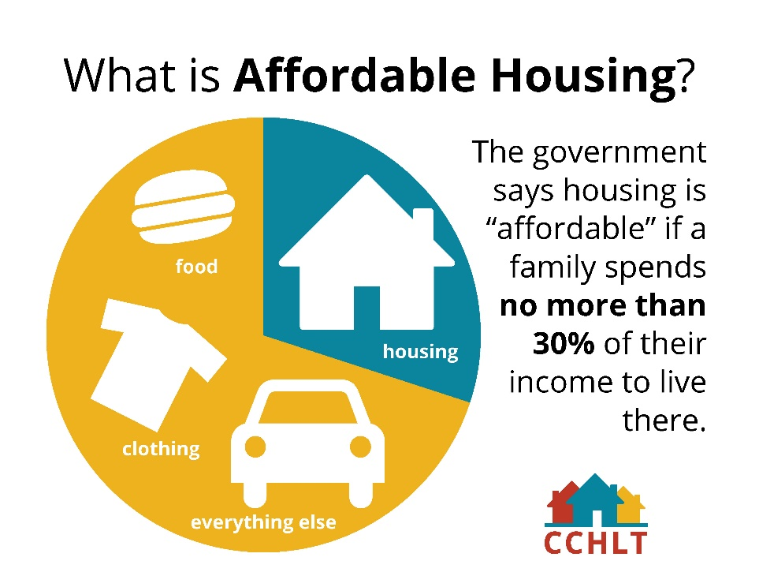
NEEDS: AFFORDABLE HOUSING
McMinnville Statistics
HOME OWNERS: 1/3 (33%) of home owners with mortgages are in unaffordable conditions
RENTERS: 1/2 (54%) of renters are in unaffordable housing
Housing is affordable if a family spends no more than 30% of household income on household expenses.
CITY COUNCIL. 2.11.20

Slide 4
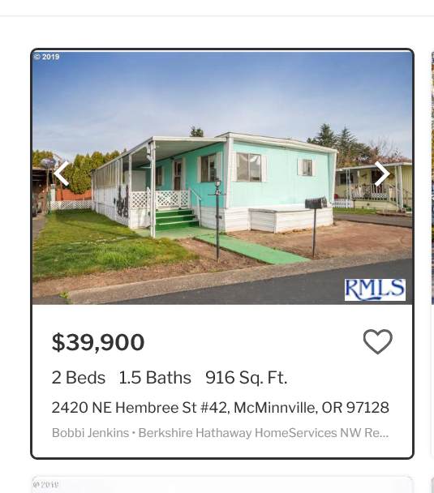
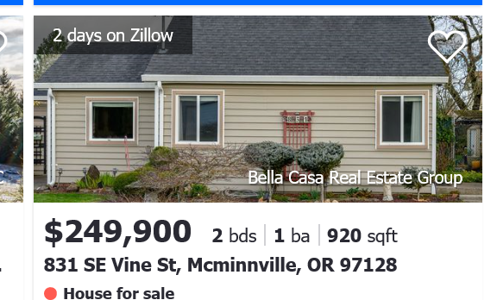
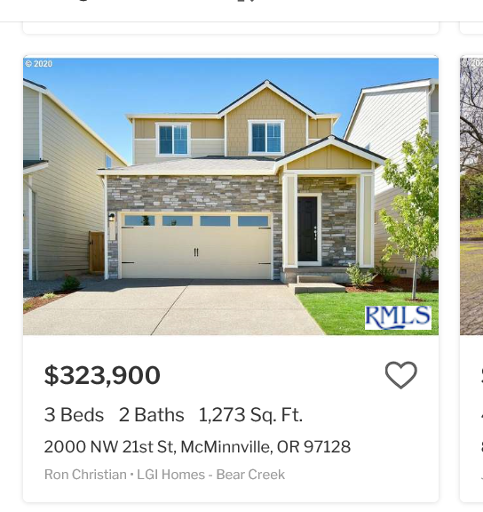
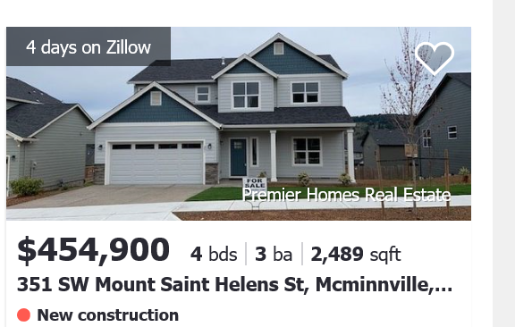
NEEDS: AFFORDABLE HOUSING
2018
2019
Median Household Income: $55,219
Median Listed Home Price = $377,450
Median Price of Home Sold = $317,000
Average rent for an apartment = $1113
Median Household Income: $57,246
Median Listed Home Price = $389,900
Median Price of Home Sold = $338,500
Average rent for an apartment = $1794
Source: Zillow, 1/13/20
CITY COUNCIL. 2.11.20

Slide 5
MCMINNVILLE – A QUICK SNAPSHOT
CITY COUNCIL. 2.11.20

Slide 6
Median Sales Price, 2012 to 2018
Source: Redfin.
Notes:
McMinnville – Increase from $140,600 (Jan 2012) to $349,000 (June 2018)
$208,400 or 148%
Other increases (Jan 2012 – June 2018):
Dallas: $119,000 or 78%
Newberg: $19,000 or 112%
Yamhill County: $195,550 or 126%

Slide 7
Median Sales Price, 2012 to 2018
Source: Redfin.
Notes:
McMinnville – Increase from $140,600 (Jan 2012) to $349,000 (June 2018)
$208,400 or 148%
Other increases (Jan 2012 – June 2018):
Dallas: $119,000 or 78%
Newberg: $19,000 or 112%
Yamhill County: $195,550 or 126%

Slide 8
Median Sales Price, 2012 to 2018
2019 = $398,200
Source: Redfin.
Notes:
McMinnville – Increase from $140,600 (Jan 2012) to $349,000 (June 2018)
$208,400 or 148%
Other increases (Jan 2012 – June 2018):
Dallas: $119,000 or 78%
Newberg: $19,000 or 112%
Yamhill County: $195,550 or 126%

Slide 9
$55,400

Slide 10
$55,400

Slide 11
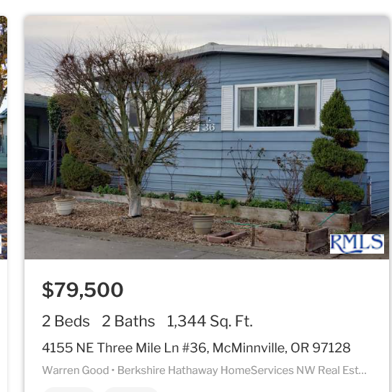
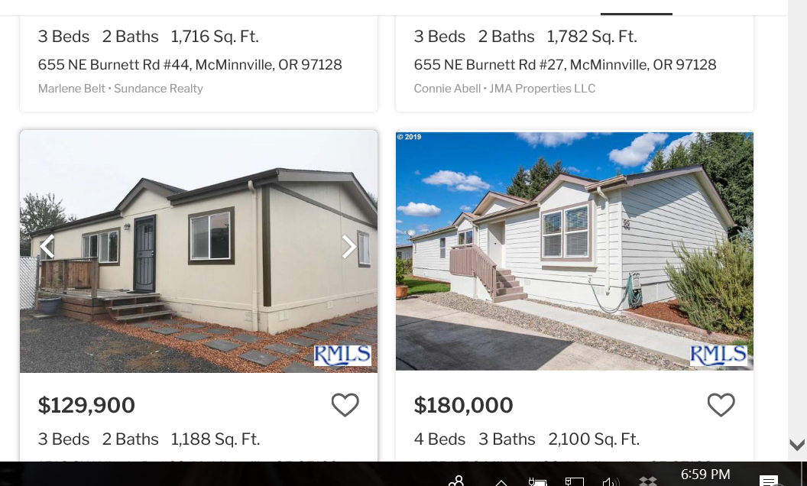
$55,400

Slide 12
SHARE OF HOUSEHOLDS BY MHI, 2017
CITY COUNCIL. 2.11.20

Slide 16
MCMINNVILLE – HOUSING DEFICIT
CITY COUNCIL. 2.11.20

Slide 17
MCMINNVILLE – HOUSING DEFICIT
From 1975 – 1999 averaged 196 units per year, including a slow growth period in the mid 1980s.
CITY COUNCIL. 2.11.20

Slide 18
MCMINNVILLE – HOUSING DEFICIT
CITY COUNCIL. 2.11.20

Slide 19
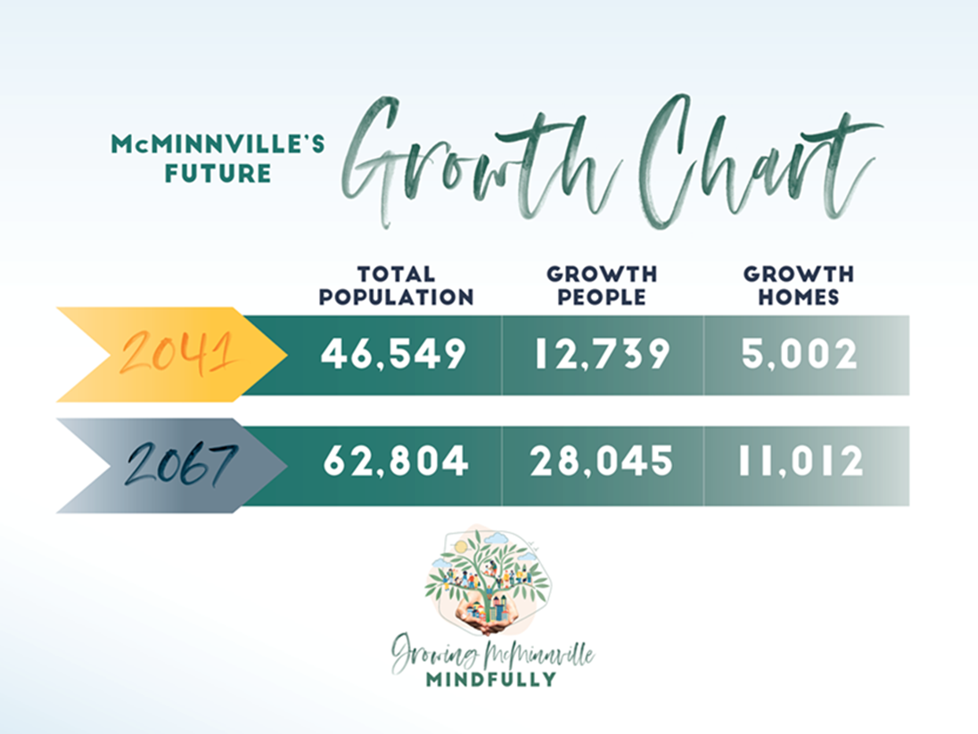

Slide 20
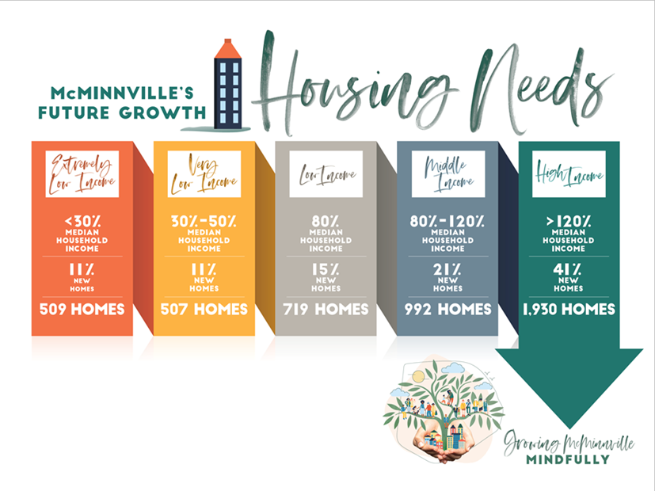

Slide 21
1016 Homes = Subsidized Housing
719 Homes = Most Likely Subsidized Housing
992 Homes = Workforce Housing
2,727 Homes = TOTAL

Slide 22
AFFORDABLE HOUSING TASK FORCE
  NINE MEMBERS:
  Remy Drabkin, McMinnville City Council
  Kellie Menke, McMinnville City Council
  Jon Johnson, Business Community
  Shannon Carefoot, Business Community
  Alan Ruden, Builder
  Howard Aster, Builder
  Mary Stern, Non-Profit Housing
  Alexandra Hendgen, Non-Profit Housing
  Mark Davis, Community At-Large
  PURPOSE:
  Review and recommend to the City Council, policies and or amendments to current zoning ordinances, Building Division review processes, System Development charge fees, street standards and other governmental policies that encourage increased access to and construction of housing for citizen earning 120% or less of McMinnville’s median income.
Meet monthly, Fourth Wednesday of each month, 10:00 AM.
CITY COUNCIL. 2.11.20

Slide 23

ACTION PLAN
THREE YEAR ACTION PLAN:
IMMEDIATE/SHORT TERM ACTIONS: (Due Date, May 1, 2017)
MID-TERM ACTIONS (Due Date, May 1, 2018)
LONG-TERM ACTIONS (Due Date, May 1, 2019)
CITY COUNCIL. 2.11.20

Slide 24
SHORT-TERM ACTIONS (May 1, 2017)
ACCOMPLISHMENTS
Memorialize Systems Development Charge discounts for affordable housing projects.
Review recently adopted inclusionary zoning law and, if warranted, draft an inclusionary zoning ordinance and present to the Council for consideration.
Offer an expedited permit process to builders including affordable housing.
Research “Cottage Codes” from other jurisdictions and, if warranted, prepare ordinance language for adoption by the Council and for inclusion in McMinnville’s zoning ordinance.
COMPLETED
UNDERWAY
COMPLETED
UNDERWAY
CITY COUNCIL. 2.11.20

Slide 25
MID-TERM ACTIONS (May 1, 2018)
Evaluate the impact of a density bonus for developers including affordable housing units.
Survey the city for property opportunities (City-owned, County-owned and Non-Profit owned). Research and evaluate creative programs to leverage these properties for affordable housing.
Review emergency shelter zoning ordinance provisions and revise as necessary to provide allowances for tiny homes or temporary shelter for residents suffering from homelessness.
UNDERWAY
UNDERWAY
UNDERWAY
CITY COUNCIL. 2.11.20

Slide 26
LONG-TERM ACTIONS (May 1, 2019)
Review the City’s inventory of surplus lands to assess for possible rezoning to multi-family housing.
Reach out to local service groups to involve them in neighborhood stabilization programs.
Conduct or partner with an outside organization to complete a needs assessment in regard to housing for the city of McMinnville.
Evaluate the possibility and sources for a local match fund for nonprofit builders.
COMPLETED
STILL TO DO
COMPLETED
UNDERWAY
CITY COUNCIL. 2.11.20

Slide 27
ACCOMPLISHMENTS
THIS YEAR
CITY COUNCIL. 2.11.20

Slide 28
ACCOMPLISHMENTS
THIS YEAR
This has been a year of due diligence and tenacity, turning over stones trying to put together an affordable housing project.
CITY COUNCIL. 2.11.20

Slide 29
ACCOMPLISHMENTS
THIS YEAR
This has been a year of due diligence and tenacity, turning over stones trying to put together an affordable housing project.
With limited results.
CITY COUNCIL. 2.11.20

Slide 30
INCLUSIONARY ZONING
  SB 1533 – ALLOWS FOR INCLUSIONARY ZONING
  City can require multi-family structures containing at least 20 units to include up to 20% of the units affordable to households at 80% or higher of area median income.
  Considerations:
  Is it needed? Today? And Long Term?
  What Zoning Districts/Geographic Areas should this apply to?
  Monitoring and Compliance of 20% of units set aside for affordable housing?
  If City chooses to do so, must provide:
  Either a Fee-In-Lieu program, or
  One of more financial incentives
  Whole of partial waiver of SDCs, permitting fees
  Finance based incentives
  Full or partial waiver of property taxes
CITY COUNCIL. 2.11.20

Slide 31
INCLUSIONARY ZONING
  SB 1533 – ALLOWS FOR INCLUSIONARY ZONING
  City can require multi-family structures containing at least 20 units to include up to 20% of the units affordable to households at 80% or higher of area median income.
  Considerations:
  Is it needed? Today? And Long Term?
  What Zoning Districts/Geographic Areas should this apply to?
  Monitoring and Compliance of 20% of units set aside for affordable housing?
  If City chooses to do so, must provide:
  Either a Fee-In-Lieu program, or
  One of more financial incentives
  Whole of partial waiver of SDCs, permitting fees
  Finance based incentives
  Full or partial waiver of property taxes
MAHTF voted to recommend to City Council.
Worked with Representative Noble on HB for pilot project in McMinnville.
Bill was gutted and stuffed with another project at the last minute in the Senate.
CITY COUNCIL. 2.11.20

Slide 32
CONSTRUCTION EXCISE TAX
  SB 1533 – ALSO ALLOWED FOR CONSTRUCTION EXCISE TAX
  City can impose up to 1% tax, based on permit valuation, on new construction and additions to square footage for affordable housing.
EXAMPLE: for residential construction:
  4% of revenue goes to city as admin fee, then the rest is divided as follows:
  50% of balance goes to fund developer incentives (see Inclusionary Zoning below),
    15% goes to OHCS (state) for down payment assistance for home ownership
    35% for affordable housing programs (using 80% AMI)
EXAMPLE: for commercial or industrial development:
  4% of revenue goes to city as admin fee, then the rest is
  divided as follows:
    50% of balance goes to fund affordable housing
    50% of balance unrestricted by the bill.
CITY COUNCIL. 2.11.20

Slide 33
CONSTRUCTION EXCISE TAX
CITY COUNCIL. 2.11.20

Slide 34
CONSTRUCTION EXCISE TAX
  SB 1533 – ALSO ALLOWED FOR CONSTRUCTION EXCISE TAX
  City can impose up to 1% tax, based on permit valuation, on new construction and additions to square footage for affordable housing.
EXAMPLE: for residential construction:
  4% of revenue goes to city as admin fee, then the rest is divided as follows:
  50% of balance goes to fund developer incentives (see Inclusionary Zoning below),
    15% goes to OHCS (state) for down payment assistance for home ownership
    35% for affordable housing programs (using 80% AMI)
EXAMPLE: for commercial or industrial development:
  4% of revenue goes to city as admin fee, then the rest is
  divided as follows:
    50% of balance goes to fund affordable housing
    50% of balance unrestricted by the bill.
Resistance from Development Community.
Find other resources as well, don’t always rely on new development for resources.
CITY COUNCIL. 2.11.20

Slide 35
No Stone Left Unturned:
Bend’s Approach to Affordable Housing
OAPA Conference
October 18, 2018
Lynne McConnell & Carolyn Eagan
Economic Development Department
Notes:
Introduce ourselves
Introduce topic via survey:
Housing crisis?
Talked to a builder?
Number of units needed?
Purpose of presentation today:
How COB got incentives in place and built 1500+ deed restricted units built. We can’t do this w/o giving credit to our builders.

Slide 36
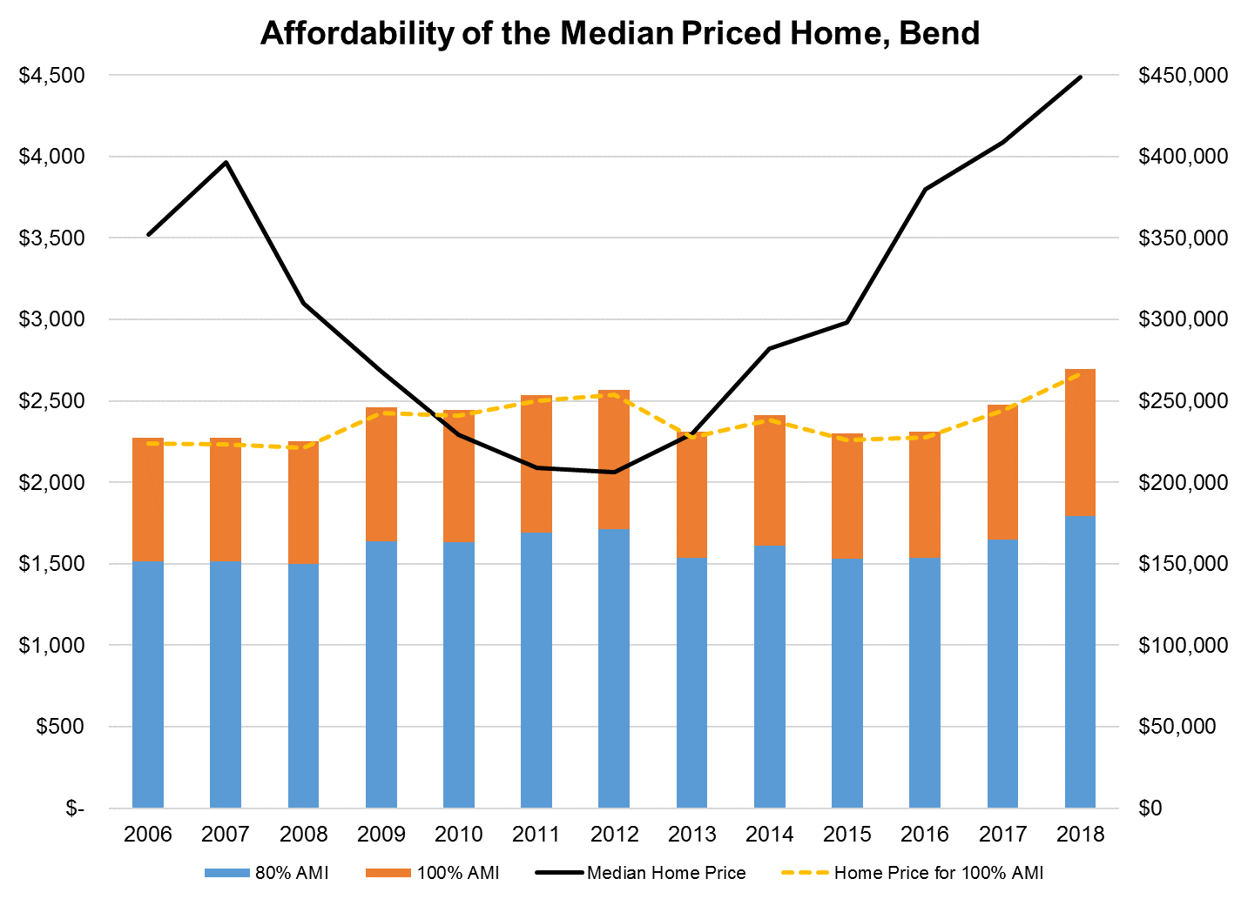
Notes:
Nordic vs Alpine
History 2000 became MPO
2004 became entitlement area
2006 CET

Slide 37
Deed restricted housing in Comp Plan
Goal of Affordable Housing not same goal as Planning
Planning Department goals = regulations
Affordable Housing goals = build as many units as you can
UGB Expansion and Housing Need
  Facilitating the desire in the market to provide solutions
  Goal 10 and 14
High level of competition between property owners
  Received proposals to include deed restricted affordable units
  All things being equal, affordable housing compelling factor
Notes:
Lynne
UGB expansion– In remand, State required us to do more for affordable housing (in our case, this was missing middle housing.
Once we were on the path to expansion, the competition for annexation was huge. Landowners voluntarily committed to provide deed restricted housing in order to be considered by the Committees and Council for inclusion.
Goal 10 – need. Providing deed restricted AH is the best way to guarantee the need is met. Otherwise it’s up to the market and easy to miss your mark. (just designating multifamily is not enough.)
Goal 14– allows for the balancing of needs.
In Bend’s case, most of the final land for selection was comparable. Thus, we were able to make a compelling social argument that AH was needed and could be a weighing factor in our findings

Slide 38
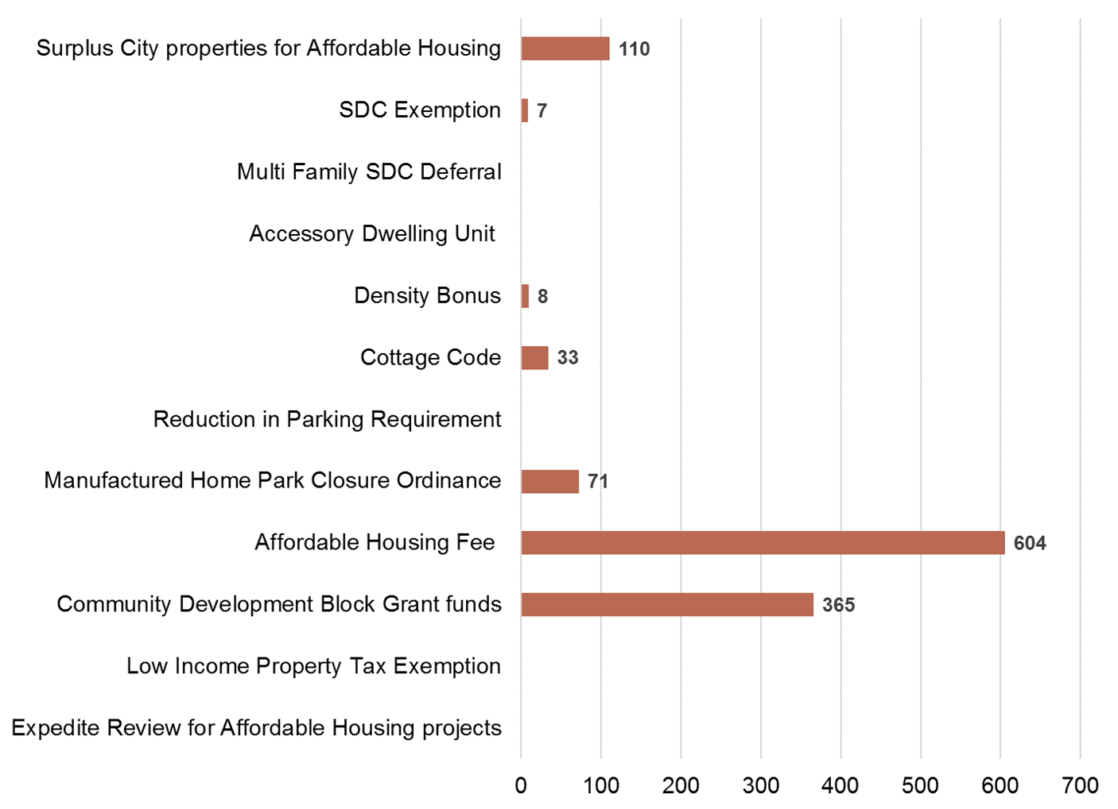
Final Results to date
Notes:
Lynne
How we are addressing the crisis
Matrix disclaimer– de-duplication, looked for tipping point, involved judgment, doesn’t show pipeline of approx. 200 units (not including HB 4079)
Bend’s serious efforts towards housing affordability began in the early 2000s with CDBG entitlement and Low Income Property Tax Exemption.
Affordable Housing Fee was created in 2006, first in the state
Surplus property method is fairly recent
What this matrix shows is that our most successful tools involve cash and land

Slide 39
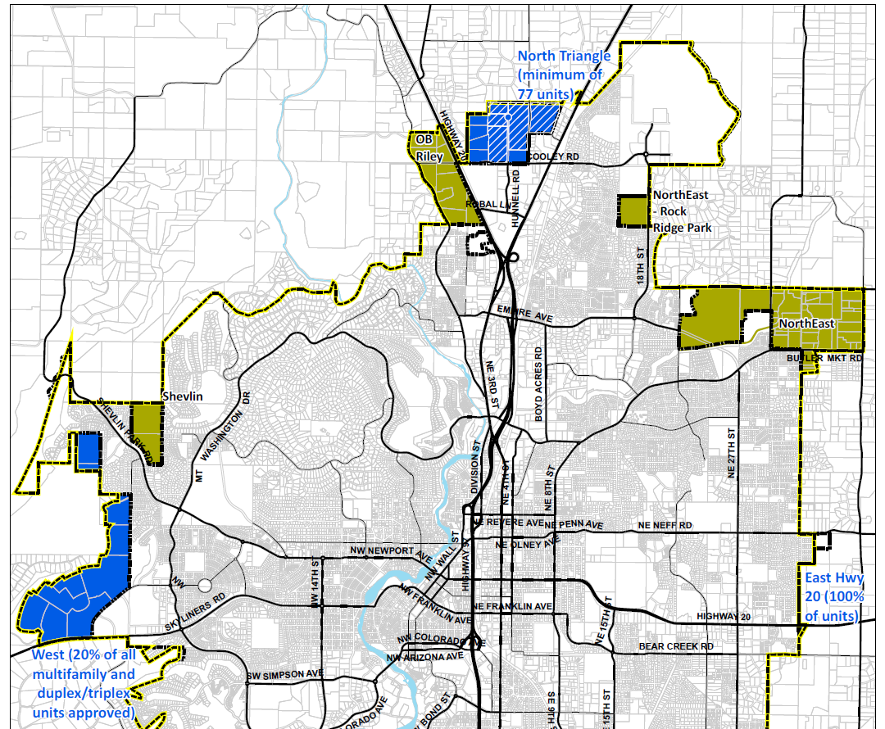
Deed Restricted Affordable Housing in UGB

Slide 40
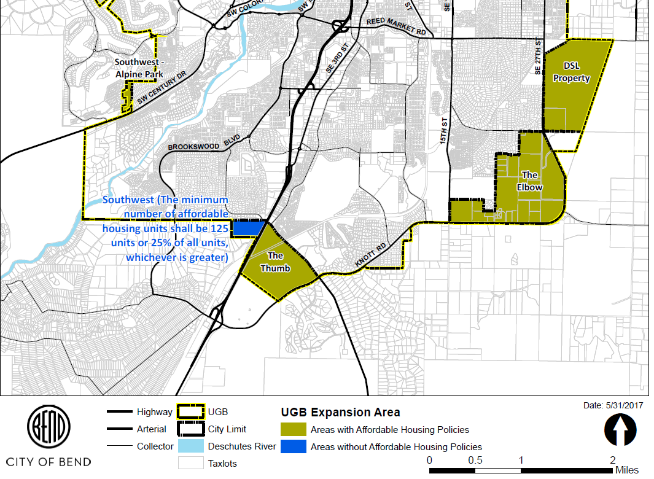
Deed Restricted Affordable Housing in UGB

Slide 41
AFFORDABLE HOUSING FUND
  Developed as part of the FY 2019/2020 Budget
  Funded by Transient Lodging Tax funds.
  $188,000
  Current uses under discussion:
  Purchase of a foreclosed property from the County for affordable housing.
  Purchase of Yamhill County Soil and Water Conservation District land for affordable housing.
  Funds Regional Homeless Coordinator in partnership with Yamhill County and Newberg
CITY COUNCIL. 2.11.20

Slide 42
AFFORDABLE HOUSING FUND
  Developed as part of the FY 2019/2020 Budget
  Funded by Transient Lodging Tax funds.
  $188,000
  Current uses under discussion:
  Purchase of a foreclosed property from the County for affordable housing.
  Purchase of Yamhill County Soil and Water Conservation District land for affordable housing.
  Funds Regional Homeless Coordinator in partnership with Yamhill County and Newberg
CITY COUNCIL. 2.11.20

Slide 43
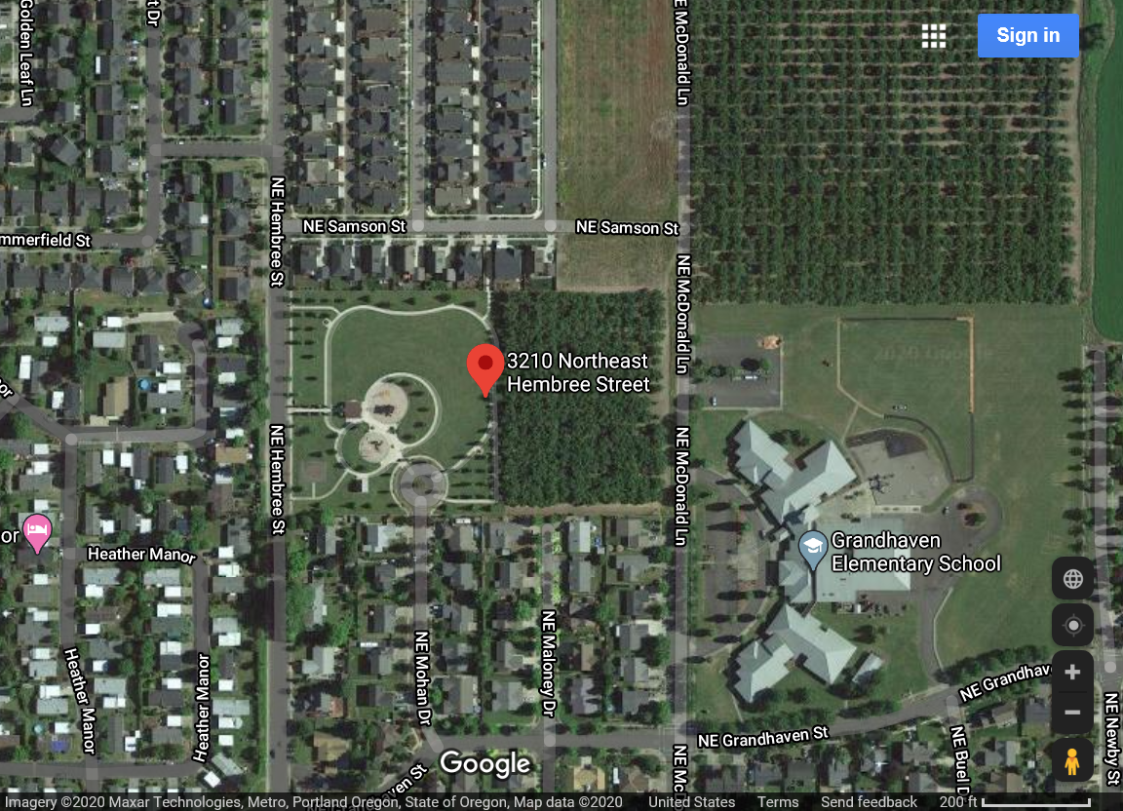
AFFORDABLE HOUSING FUND
  Developed as part of the FY 2019/2020 Budget
  Funded by Transient Lodging Tax funds.
  $188,000
  Current uses under discussion:
  Purchase of a foreclosed property from the County for affordable housing.
  Purchase of Yamhill County Soil and Water Conservation District land for affordable housing.
  Funds Regional Homeless Coordinator in partnership with Yamhill County and Newberg
CITY COUNCIL. 2.11.20

Slide 44
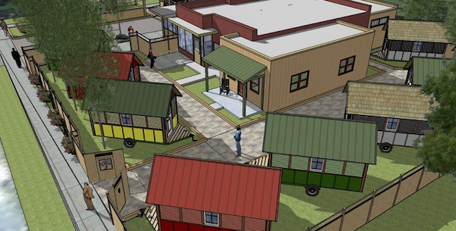
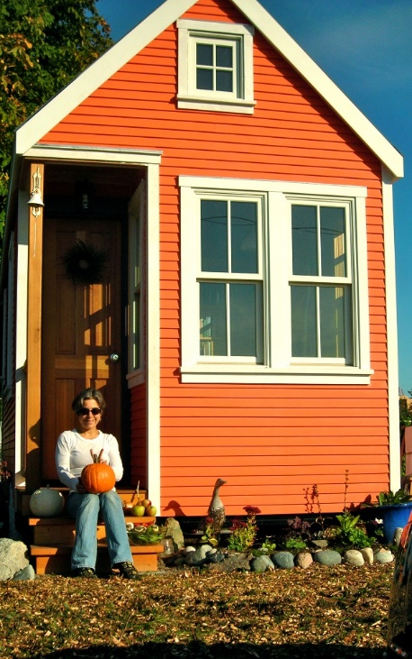
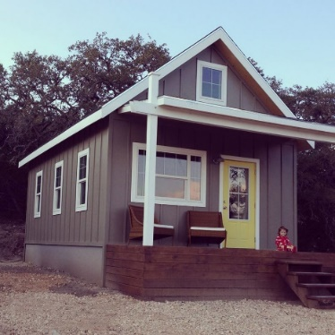
EMERGENCY SHELTER ORDINANCE
Floating Zone Ordinance - Modeled after Portland, Oregon
Draft a floating zone that allows for one or two pilot projects for emergency housing to serve housing/homeless needs.
Zone will have criteria for development and standards to mitigate impact to neighboring properties.
CITY COUNCIL. 2.11.20

Slide 45
TRIED TO CREATE OPPORTUNITIES
$325,000,000 IN FUNDS AVAILABLE FOR AFFORDABLE HOUSING PROJECTS
CITY COUNCIL. 2.11.20
Notes:
Across the State, demand for housing has outpaced the supply of new housing coming on the market. The unsurprising outcome is an affordability crisis that affects all Oregonians and disproportionately affects lower and middle-income households leading to homelessness increasing in the past few years.

Slide 46
SUBSIDIZED HOUSING PARTNERSHIPS
PARTNER OUTREACH – 2019
Met with Housing Authority Board
Brought in potential partners from Salem to discuss projects.
Hosted developers to develop projects.
Agreed to be pilot project for OHCS project readiness program.
Lobbied for OHCS land acquisition funds to be opened to larger cities.
CITY COUNCIL. 2.11.20

Slide 47
PROPERTY OPPORTUNITIES
City
County
Non-Profit
CITY COUNCIL. 2.11.20

Slide 48
HOUSING FOR HOMELESS SUBCOMMITTEE
HOUSING FOR HOMELESS BETTER SERVED IN DEDICATED SUBCOMMITTEE DISCUSSION
Subcommittee Formed in February/March 2017 – Effort to make it broad-based community representation.
Folded back into the AHTF
in 2020.
Sub-Committee Members
Lindsey Manfrin, Yamhill County HHS, Chair
Remy Drabkin, McMinnville City Council
Mary Starrett, Yamhill County Commission
Heather Richards, McMinnville Planning Department
Mary Stern, MAHTF
Dave Haugeberg, Gospel Rescue Mission
Marci Ingram, MSD 40
Scott Hill, Mayor – McMinnville
Alexandra Hendgen YCAP
CITY COUNCIL. 11.13.18

Slide 49
HOUSING FOR HOMELESS SUBCOMMITTEE
Focus on subset of populations experiencing homelessness and dedicating action plans towards achieving incremental success.
Youth
Senior Women
Vehicular Homeless
Veterans
CITY COUNCIL. 11.13.18
CITY COUNCIL. 11.13.18

Slide 50
VEHICULAR HOMELESS
Partnership between Champion Team,
City of McMinnville and Property Owners
CITY COUNCIL. 2.11.20

Slide 51
CITY PROGRAMS
TINY HOME PARTNERSHIPS:
BLANCHET HOUSE – 2017, 2018
Worked with Portland for Building Permits
Volunteered to be pilot city when Portland did not work out.
Building Official and Inspectors volunteer on-sight inspections and foundation design
Developed partnership with MSD
CITY COUNCIL. 2.11.20

Slide 52
TINY HOME PARTNERSHIPS - MSD
Partnership between EASA,
City of McMinnville and Church
CITY COUNCIL. 2.11.20

Slide 53
TINY HOME CLUSTER FOR SENIOR WOMEN
CITY COUNCIL. 2.11.20

Slide 54
CITY PROGRAMS
TINY HOME PARTNERSHIPS:
HOPE ON THE HILL – 2018, 2019
Facilitated partnership with private property owner.
Hosted granting agencies to support development.
Developed floating zone concept
Developed partnership with MSD and Blanchet House
CITY COUNCIL. 2.11.20

Slide 55
CITY PROGRAMS
TINY HOME PARTNERSHIPS:
BLANCHET HOUSE – 2017, 2018
Worked with Portland for Building Permits
Volunteered to be pilot city when Portland did not work out.
Building Official and Inspectors volunteer on-sight inspections and foundation design
Developed partnership with MSD
Could not find any land for project – churches, private property, non-profits
CITY COUNCIL. 2.11.20

Slide 56
THIS YEAR
Dustin Court and Marsh Lane:
New Subcommittee / Work Plans:
Communication Plan –
Efforts Underway and Data Disbursement
Evaluating Chronically Homeless Solutions – Shelter and Continuum of Care Program
Increasing Shelter Opportunities for Youth
CITY COUNCIL. 2.11.20

Slide 57
NEXT STEPS – NEW ACTION PLAN
ON-GOING:
Evaluate Programs to Fund Affordable Housing (City Influence):
Transient lodging tax funds for affordable housing
Urban renewal funds or tax increment financing
Construction Excise Tax
Community Development Block Grant funds
Support Partners Pursuit of Affordable Housing Funds for:
Low Income Housing Tax Credit
Home Ownership Programs
Oregon Affordable Housing Tax Credit
Housing Rehabilitation Program
State Affordable Housing Funding
CITY COUNCIL. 2.11.20

Slide 58
SHORT-TERM ACTIONS (Dec. 31, 2020)
Review emergency shelter zoning ordinance provisions and revise as necessary to provide allowance for tiny homes or temporary shelter to residents suffering from homelessness.
Evaluate the impact of a density bonus for developers including affordable housing units.
Allow Duplexes, Cottages, Townhomes, Row Houses and Tri- and Quad-Plexes in single family zones with appropriate design and development standards.
Promote infill development, allowing flexibility in existing zones with appropriate design and development standards.
Allow Co-Housing and Group Quarters (SROs, etc.)
Allow small or “tiny” homes and identify opportunities for tiny home developments.
Evaluate parking code as a barrier to housing.
CITY COUNCIL. 2.11.20

Slide 59
MID-TERM ACTIONS (Dec. 31, 2021)
Develop a High-Density Residential Zone
Develop a Community Land Trust
Pursue a land bank for affordable housing
Advocate for Inclusionary Zoning enablement – State Legislation and Annexation Processes
Explore a Multiple Unit Limited Tax Exemption Program (Locally enabled and managed)
Explore an affordable housing property tax abatement
CITY COUNCIL. 2.11.20

Slide 60
LONG-TERM ACTIONS (Dec. 31, 2022)
Evaluate transfer of density for protection of natural features.
Develop financial incentives supporting inclusionary zoning.
Explore a vacant property tax
Explore a fee for demolition of affordable home for expensive home.
CITY COUNCIL. 2.11.20

Slide 61
2000
AFFORDABLE HOUSING TASK FORCE
Meets: Fourth Wednesday of Month,
10:00 – 11:00 am, CDC, 231 NE 5th
Chairperson,
Remy Drabkin
Remy.Drabkin@mcminnvilleoregon.gov
2020 - ?
2020
2010
CITY COUNCIL. 2.11.20

