Slide 1

Friends of Yamhill County (FYC) and 1000 Friends of Oregon members support Oregon land use program and development consistent with McMinnville’s comprehensive plan.

Slide 2
McMinnville Plan Policies: Economy
21.02 The City shall encourage and support the start up, expansion or relocation of high-wage businesses to McMinnville.
21.03 The City shall support existing businesses and industries and the establishment of locally owned, managed, or controlled small businesses.
No policies encouraging or supporting more large-format retail.

Slide 3
McMinnville Plan Policies: Urbanization
187.30 “The Great Neighborhood Principles shall be applied in all areas of the city to ensure equitable access to a livable, egalitarian, healthy, social, inclusive, safe, and vibrant neighborhood for all McMinnville citizens.”

Slide 4
We support:
All uses north of the expressway, especially the mixed-use neighborhood
The Innovation Center and family-wage jobs
A future trail network, pedestrian bridge, urban design features and residential and mixed-uses
Commercial services scaled to those who live and work in the area

Slide 5
TMLAP: Large Retail Shopping Center South of the Expressway
33 net acres per traffic modeling
40-60 acres per actual TMLAP Language
62 net acres per pending applications
Nothing limits store size, total retail area, or the number of drive up windows
Across an expressway from the rest of town

Slide 6

Pending zone change applications for 62 acre shopping center
Staff Recommendation
3 stores exceeding 135,000 sq. ft. with no upper size limit
An unlimited number of stores up to 135,000 sq. ft.

Slide 7
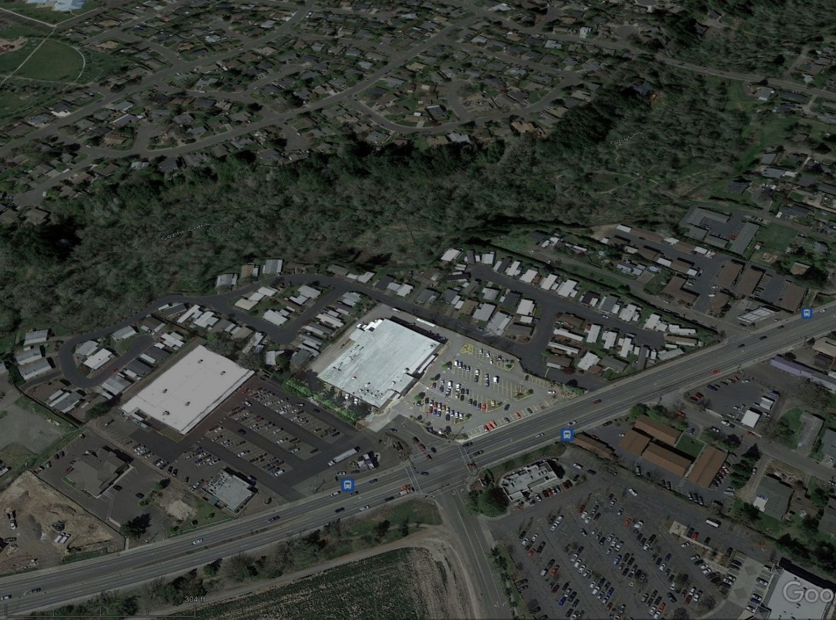
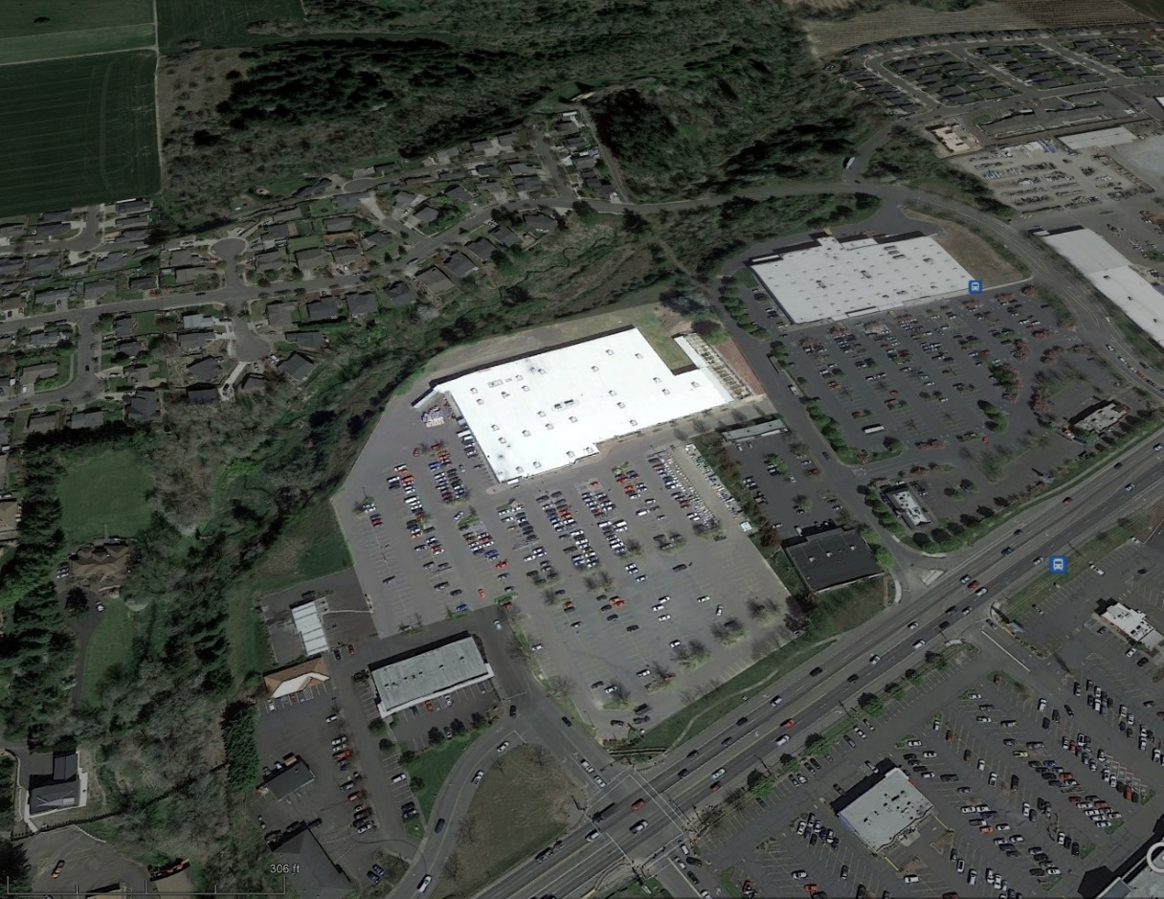
Roths Walmart
38,411 SF of floor space 101,365 sq. ft. of floor space
Source: Yamhill County Assessors office Source: Yamhill County Assessors office

Slide 8
Orenco Station: 12 acres
Largest anchor store: 29,000 sq. ft. grocery
125,503 SF of commercial uses including retail, medical offices, a bank, a real estate office, etc.
Source: PacTrust Orenco Station Lease Packet

Slide 9
Old Mill District:
17 acre retail area
Largest anchor store: 28,000 SF (REI)
Total Retail Floor Area: 267,000 SF
River Path to Downtown
Source: Old Mill District Marketing Brochure (https://images1.loopnet.com/d2/YljmPpBC2V8nSWqPrVyVdw8u7NHfyEAEZh99SFIOKiw/document.pdf)

Slide 10
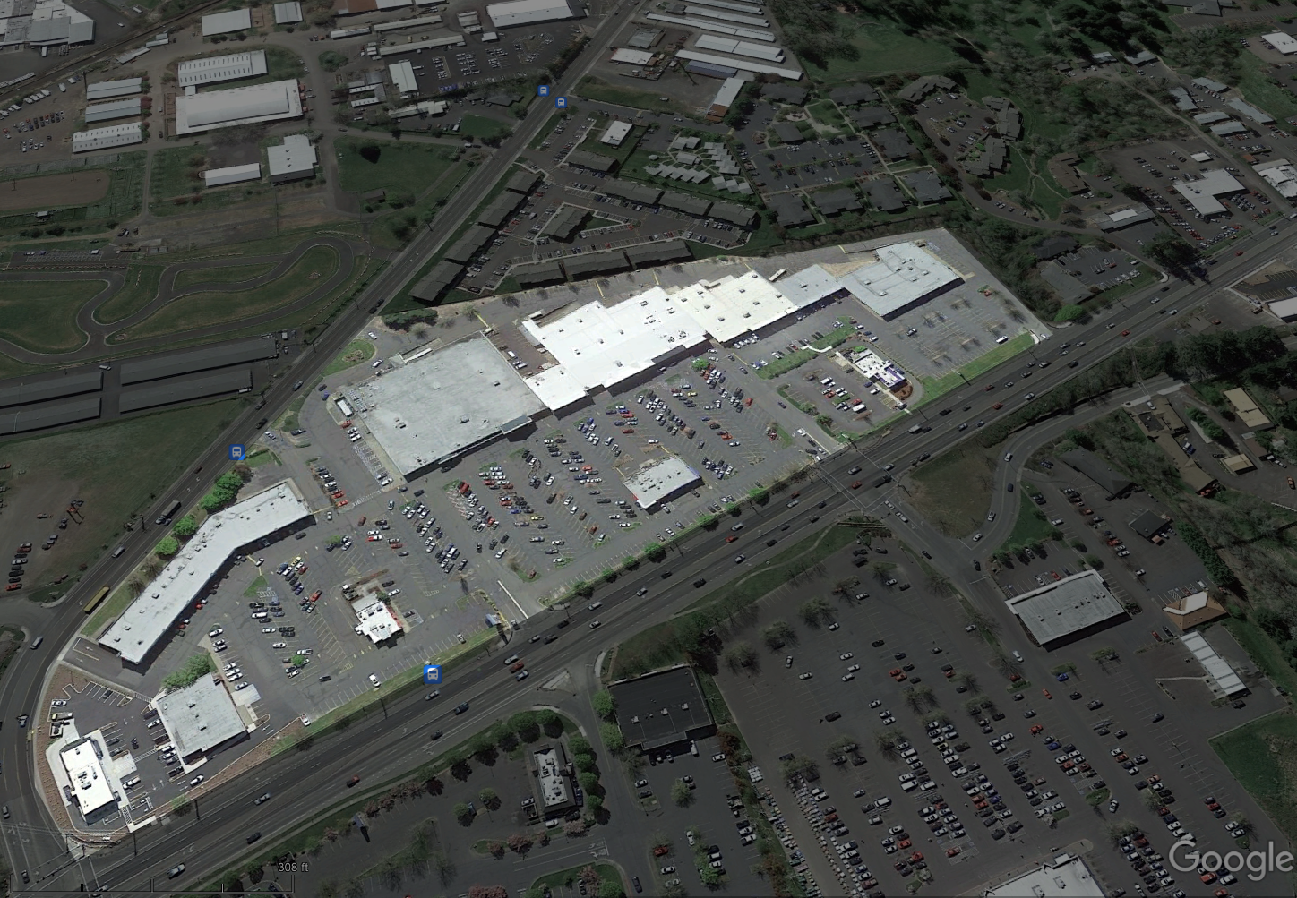
Safeway Plaza: 18 acres
(Safeway building 56,379 SF)
Source: Marcus & Millichap McMinnville Safeway Lease Packet

Slide 11
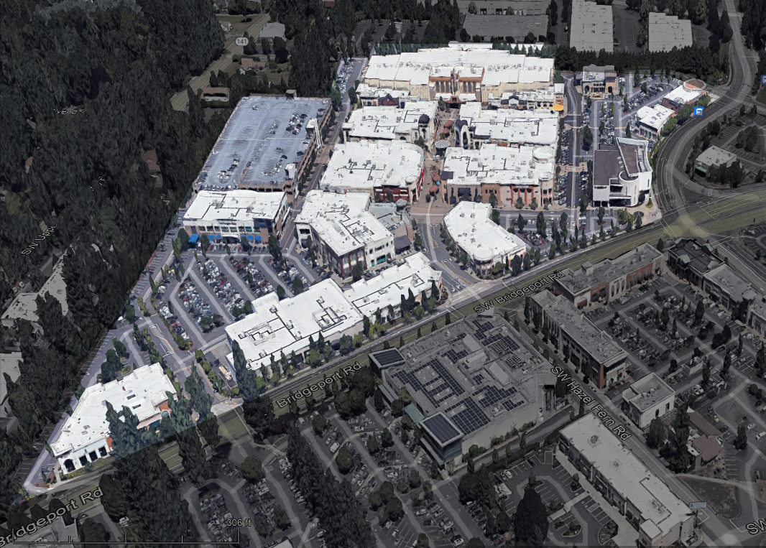
Bridgeport Village: 30 acres
Total Retail Floor Area: 465,000 SF
Source: https://en.wikipedia.org/wiki/Bridgeport_Village_(Oregon)

Slide 12
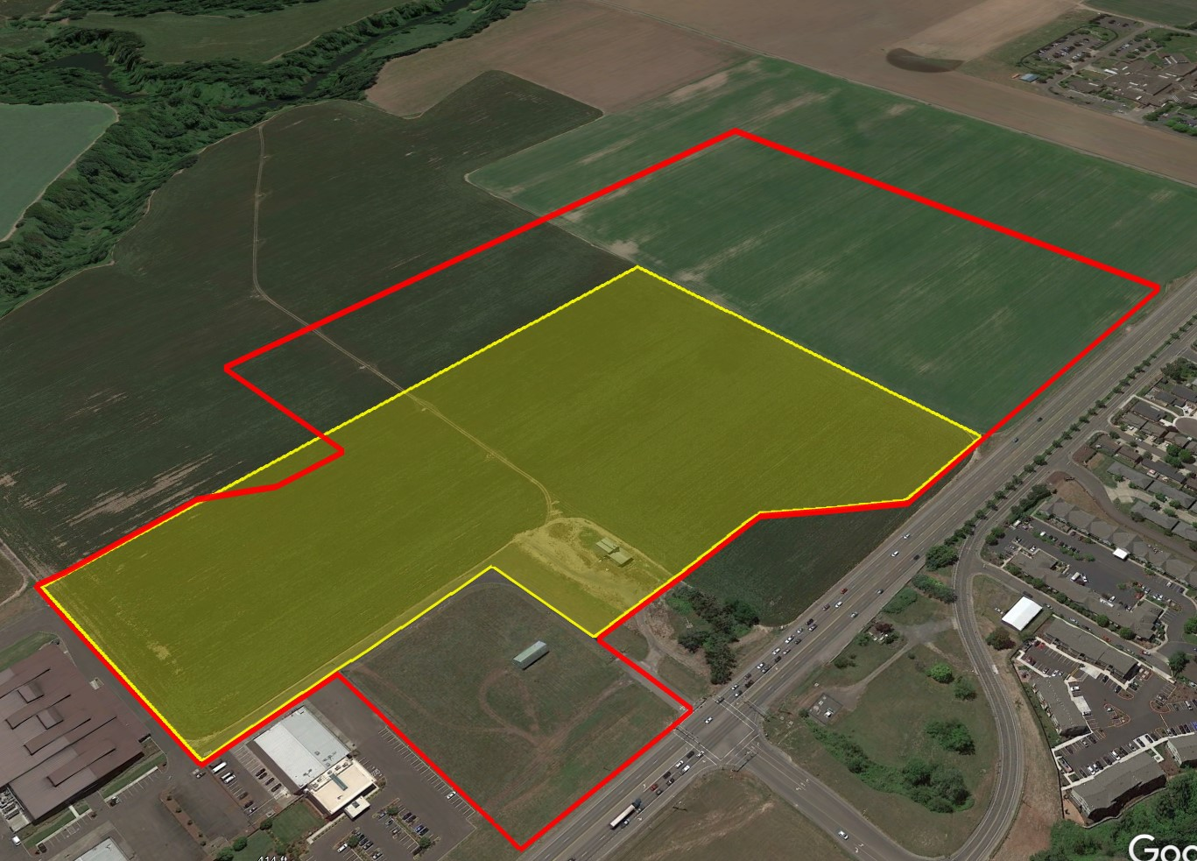
TMLAP: 33 acre shopping center (yellow) 62 acre shopping center (red)
Total Retail Floor Area: 364,815 SF Total Retail Floor Area: 683,000
Largest Anchor Stores: No upper limit
Sources: https://www.mcminnvilleoregon.gov/sites/default/files/fileattachments/planning/page/21877/3._tia.pdf https://www.mcminnvilleoregon.gov/planning/page/comprehensive-plan-map-amendmentzone-change-cpa-2-21zc-3-21

Slide 13
McMinnville’s future rests on:
A healthy downtown and commercial core on Highway 99W
The expansion and retention of existing businesses
New employers providing family-wage jobs
A 33 acre retail shopping center threatens this future
A 62 acre retail shopping center would nearly double those impacts
Notes:
Large Shopping Center south of the bypass risk this future

Slide 14
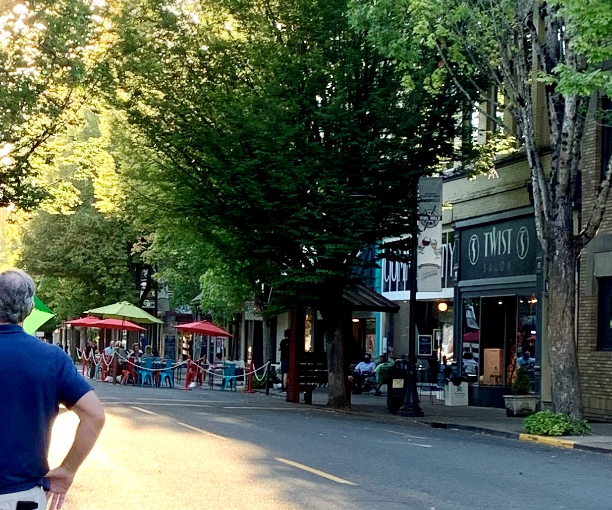
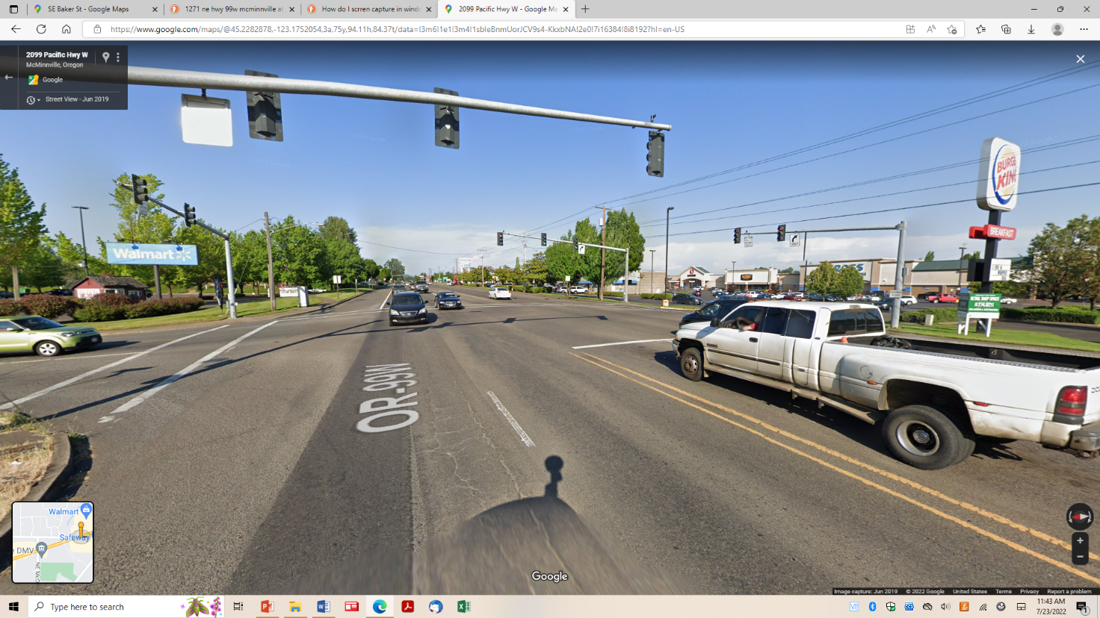
McMinnville has a “human-scaled”, pedestrian-friendly town Center
Larger Retailers are located throughout the Highway 99W corridor

Slide 15
From Applicant’s traffic study for 33 net acre shopping center:
“many trips… that currently travel to the downtown area today will alter their trips to visit the new commercial businesses and thus reduce trips entering the downtown areas.”

Slide 16

Rick Nys, P.E.
Principal Traffic Engineer
Registered Professional Engineer in Oregon
23 years experience traffic engineering/transportation planning
Worked in both private and public sectors
Reviewed TMLAP traffic impacts for Friends of Yamhill County

Slide 17
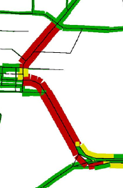
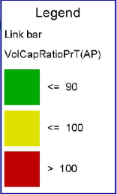
Study area limited
Few intersections included outside study
area. Study excludes Hwy 18/Kreder Rd
99W/Hwy 18/McDougall Rd,
Hwy 18/Lafayette Hwy
City TSP illustrates multiple v/c
failures downtown
yet analyzed only 3ML/1st St
The plan has unknown impacts
to other intersections

Slide 18
Pending zone changes and UGB changes
Plan considers traffic impacts of 33 acres of zone changes, but 62 acres of zone changes are pending review
Zone changes may result in increase of traffic volume of over 6,000 vehicles per day
Plan is already not consistent with what is proposed
662 acres brought into McMinnville UGB, 27 acres are within this plan area –traffic study considers none of these impacts

Slide 19
Intersection Operations
Plan illustrates v/c of 0.76 at OR 18/Norton
City's consultant presented alternative results of 0.78, just 0.02 below mobility standard of 0.80
Errors, omissions, or lack of construction of any of the millions of dollars of assumed improvements of the plan could affect the operations at this intersection and others
Without ALL of the improvements in place, the operations are unknown
Developers likely cannot construct all improvements

Slide 20
Net Retail Leakage is Virtually Non-existent
Net retail leakage in McMinnville is $9,276,030
In a city of 35,000, this is $265 per person
Total Est. Household Demand $709,369,536
Total Est. Sales $700,163,506
Net Retail Leakage $9,276,030
Source: Table 8 (p. 33) of Three Mile Lane Market Analysis at p. 96 of TMLAP Appendix B

Slide 21
McMinnville has a net inflow of retail dollars

Slide 22
McMinnville has a commercial land surplus of at least 30 acres
“in terms of state law, the city has the option to either go ahead with or pull back from the proposed conversion from industrial to commercial for this particular area...” Gordon Howard, Community Services Division Manager, Oregon Department of Land Conservation and Development, email to McMinnville Planning Director, dated June 14, 2022

Slide 23
Commercial uses should be neighborhood-scaled and neighborhood-serving.
Neighborhood Activity Center standards
McMinnville Zoning Ordinance section 17.50:
Up to 10 acres retail commercial
Up to 100,000 total retail floor space
Largest allowed retailer- 40,000 sq. ft. grocery
Additional non-retail commercial uses (professional offices, day care, services, etc.)
Even if the Council disagrees, all commercial uses in the “retail area” south of the expressway must not exceed the 33 acres used for transportation modeling

Slide 24
McMinnville Plan Policies: Economy
21.02 The City shall encourage and support the start up, expansion or relocation of high-wage businesses to McMinnville.
21.03 The City shall support existing businesses and industries and the establishment of locally owned, managed, or controlled small businesses.
No policies encouraging or supporting more large-format retail.

Slide 26
Recommendations: Use Neighborhood Activity Center Standards or amend the TMLAP with standards that are specific to the Three Mile Lane Area.
New commercial uses south of the expressway should serve neighborhood residents
  Incorporate an upper limit on store size and total amount of retail floor space
  Limit total retail acreage. Additional commercial land for non-retail commercial uses to serve those who live and work in the area.

Slide 27
Recommendations:
Require adherence to the Great Neighborhood Principles
Encourage true mixed-use and the provision of needed housing. Allow residential units in all areas not within the airport approach zones or areas of natural hazards.
Consider rezoning existing M-2 zoned area to M-1 or M-L to address concerns over potentially noxious industrial uses
Include within the TMLAP, land between the air museum and Highway 18 added to the UGB in 2020
Repeal Plan Policy 48.70, since the city now has a surplus of commercial land

Slide 28
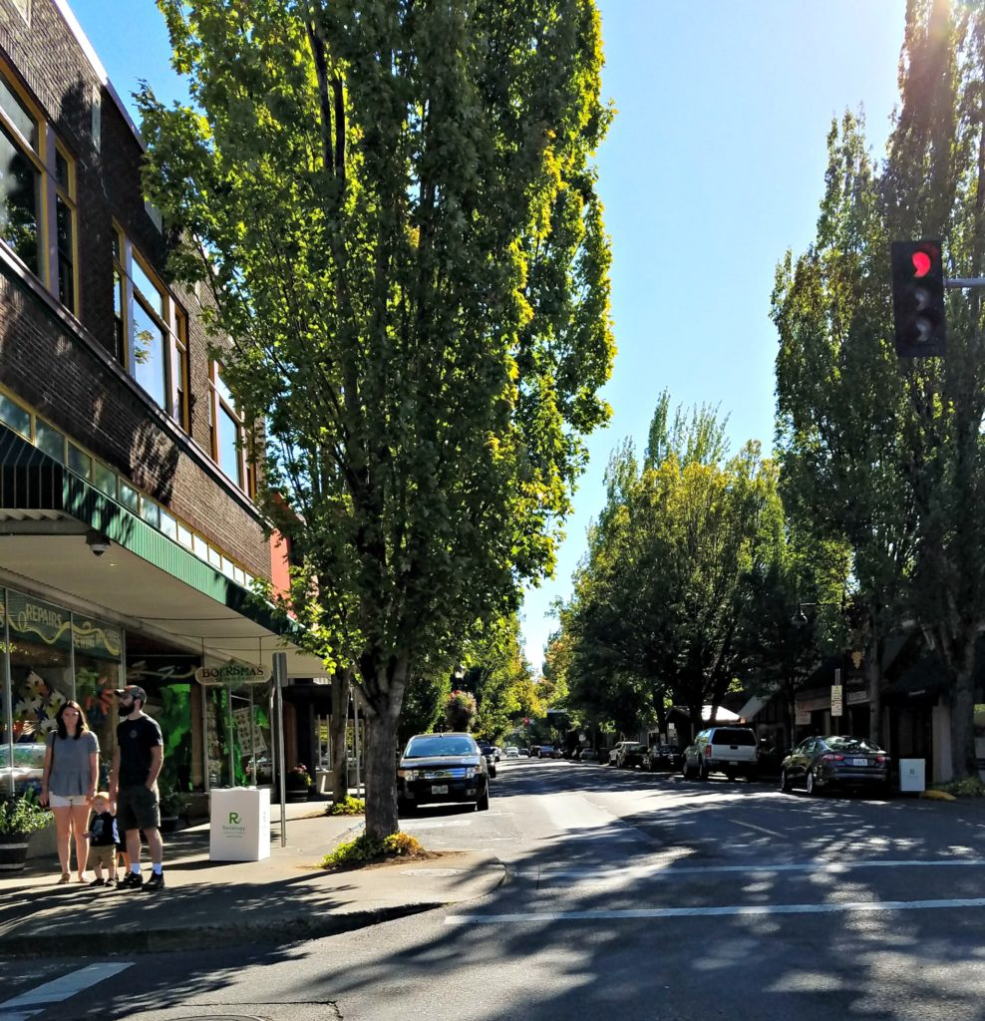
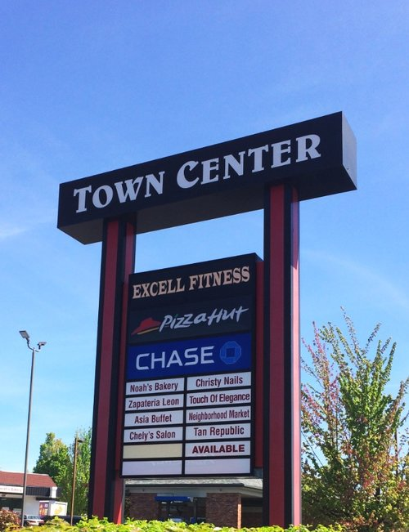
Do we need a third town center?

Slide 29
Thank you!
We’d be happy to
answer any questions.

